Slide 1
Sun Safety Education Program
Grades 4 & 5
© CSCF2013
Notes:
Start by introducing yourself (name, school you go to, etc.).

Slide 2
Objectives
What is skin cancer?
Where does it come from?
What can we do to prevent it?
© CSCF2013
Notes:
(Read slide)

Slide 3
What Causes Skin Cancer?
Sun
Watching too much TV
Pizza Pops
UV Radiation
Tanning Beds
Cell phones
DNA mutations
Microwave
© CSCF2013
Notes:
Let’s test how much you know already… Raise your hand if you think skin cancer comes from the sun?
(Clicking on this slide will show each correct answer as you go through the list. Answers are: the sun, UV radiation, tanning beds and DNA mutations)

Slide 4
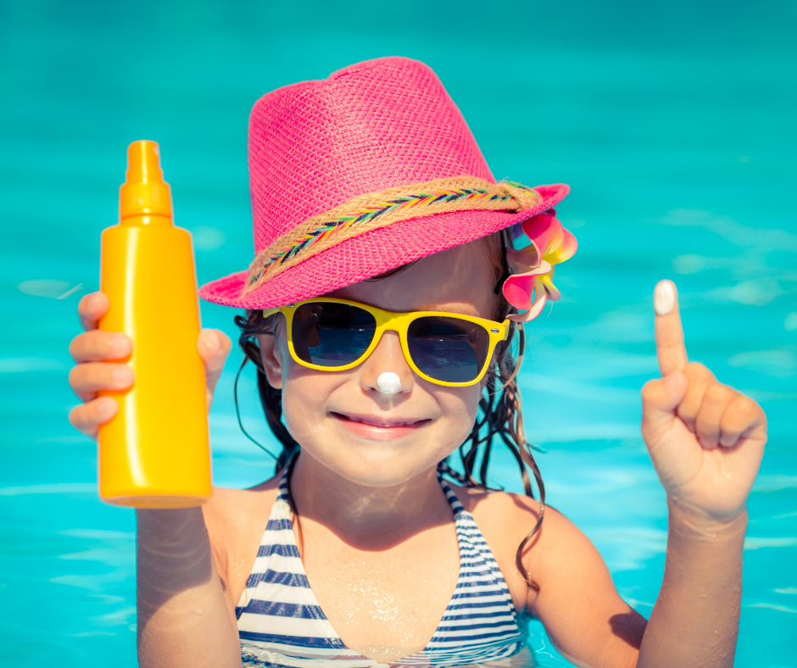
Sun Safety!
Regardless of your skin colour, it is important to always practice sun safety and to protect your skin from sun damage!
© CSCF2013
Notes:
(Read slide)

Slide 5
Skin Colour
People all around the world have different skin colours
Different skin colours offer different protection from the sun
© CSCF2013
Notes:
(Read slide)
Darker skinned people might not get as many sunburns as lighter skinned people, but absolutely everyone needs to protect their skin. It doesn’t matter what your skin color is, everyone should practice sun safety.

Slide 6
Who Is Most At Risk?
People with lighter skin tones and lighter features are more sensitive to the sun’s UV rays
People who have more than 50 moles on their bodies
People with darker skin tones and darker features are actually less sensitive to UV rays because they have more melanin production
Notes:
(Read Slide)
(If you can communicate with the class, you can ask if anyone knows what melanin is)

Slide 7
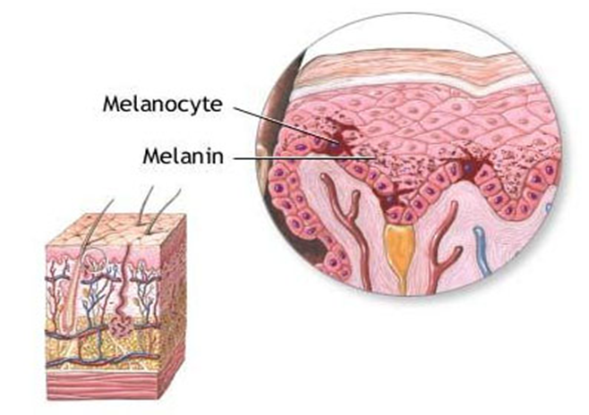
Melanin
Is produced by your skin cells
Melanin turns dark (and gives you a tan) when exposed to the suns rays
A tan means that the damage has already been done!
© CSCF2013
Notes:
Melanin is produced by your skin cells. It’s what gives your hair and skin its color. It turns dark and gives you a tan to try to protect you from UV rays from the sun. However, having a tan means you already have sun damage.

Slide 8
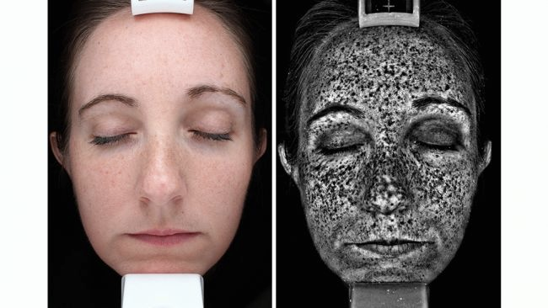
Why Is Sun Safety Important?
Because the sun’s UV rays can cause sun damage and can lead to skin cancer!
© CSCF2013
Notes:
(Read slide)
UV rays from the sun can cause sun damage, and sun damage can sometimes lead to skin cancer.
Sun damage is not always so obvious. In the first picture, we see that she doesn’t have a tan or a sunburn, so we might think she doesn’t have any sun damage. However, the second picture, taken with a special camera, shows all the spots on her face where she has sun damage.
(If you can interact with the class, ask “where on her face does she have the most damage?” Most common answer is her nose.)
So, just because you don’t see it doesn’t mean it’s not there.
However, having sun damage does not mean you will definitely get skin cancer; it only means you are more at risk.

Slide 9
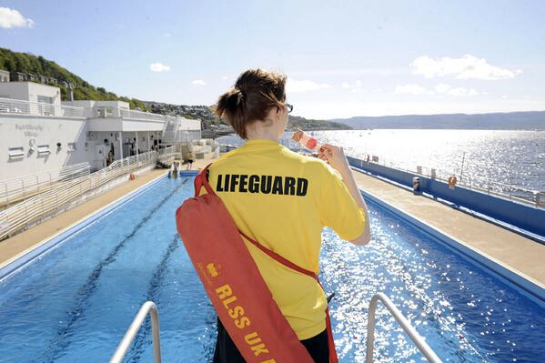
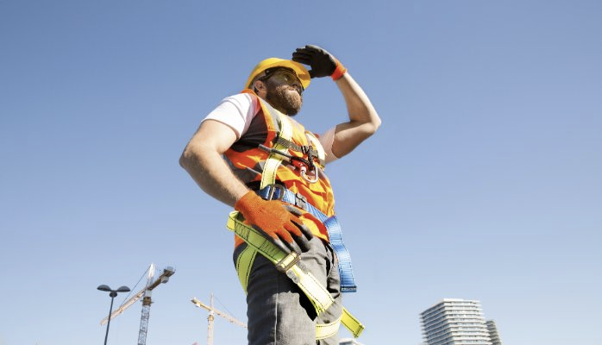
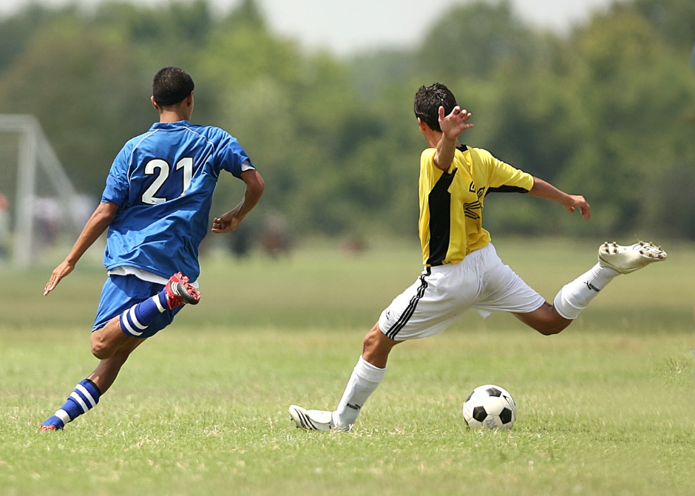
Who Else Is At Risk?
People who spend long periods of time in the sun need to learn sun safe habits!
© CSCF2013
Notes:
People who spend a lot of their time outside are more at risk. Sometimes people have jobs that take place outside, like construction workers, or lifeguards. Some people also have hobbies that take place outside, like people who go hiking or do outdoor sports.
All of these people are spending so much of their time outside, so they need to be especially careful.

Slide 10
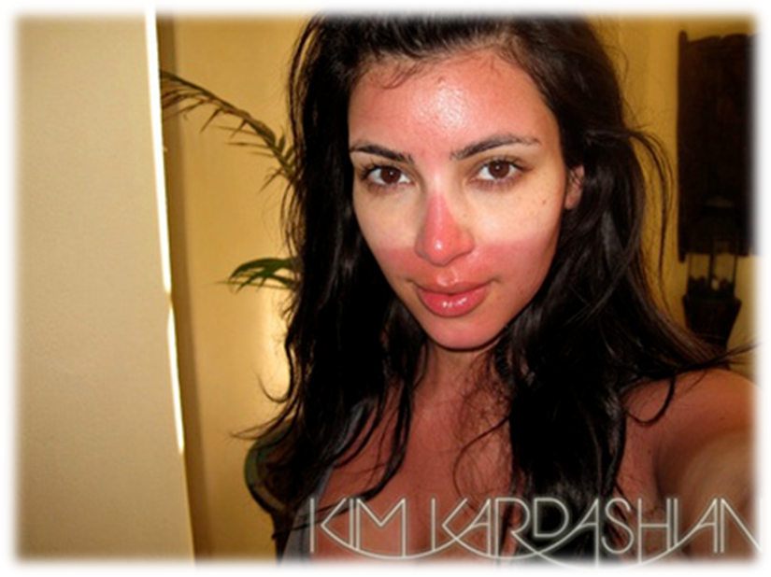
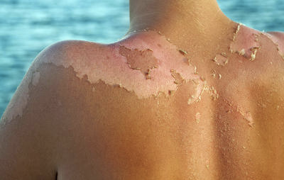
Sun Damage
What are the signs of sun damage?
Redness
Skin peeling off
Sunburn!
© CSCF2013
Notes:
Raise your hand if you’ve ever had a sunburn?
Some of us might already familiar with what sunburns look like. On the right, we have Kim Kardashian showing off her sunburn, where you can see that her skin is red all over, except around her eyes where she had her sunglasses.
The picture on the left shows how some sunburns might cause your skin to peel off. Severe sunburns can also be quite painful.
For those of you who’ve had sunburns, were they painful? Then we definitely want to avoid those in the future.

Slide 11
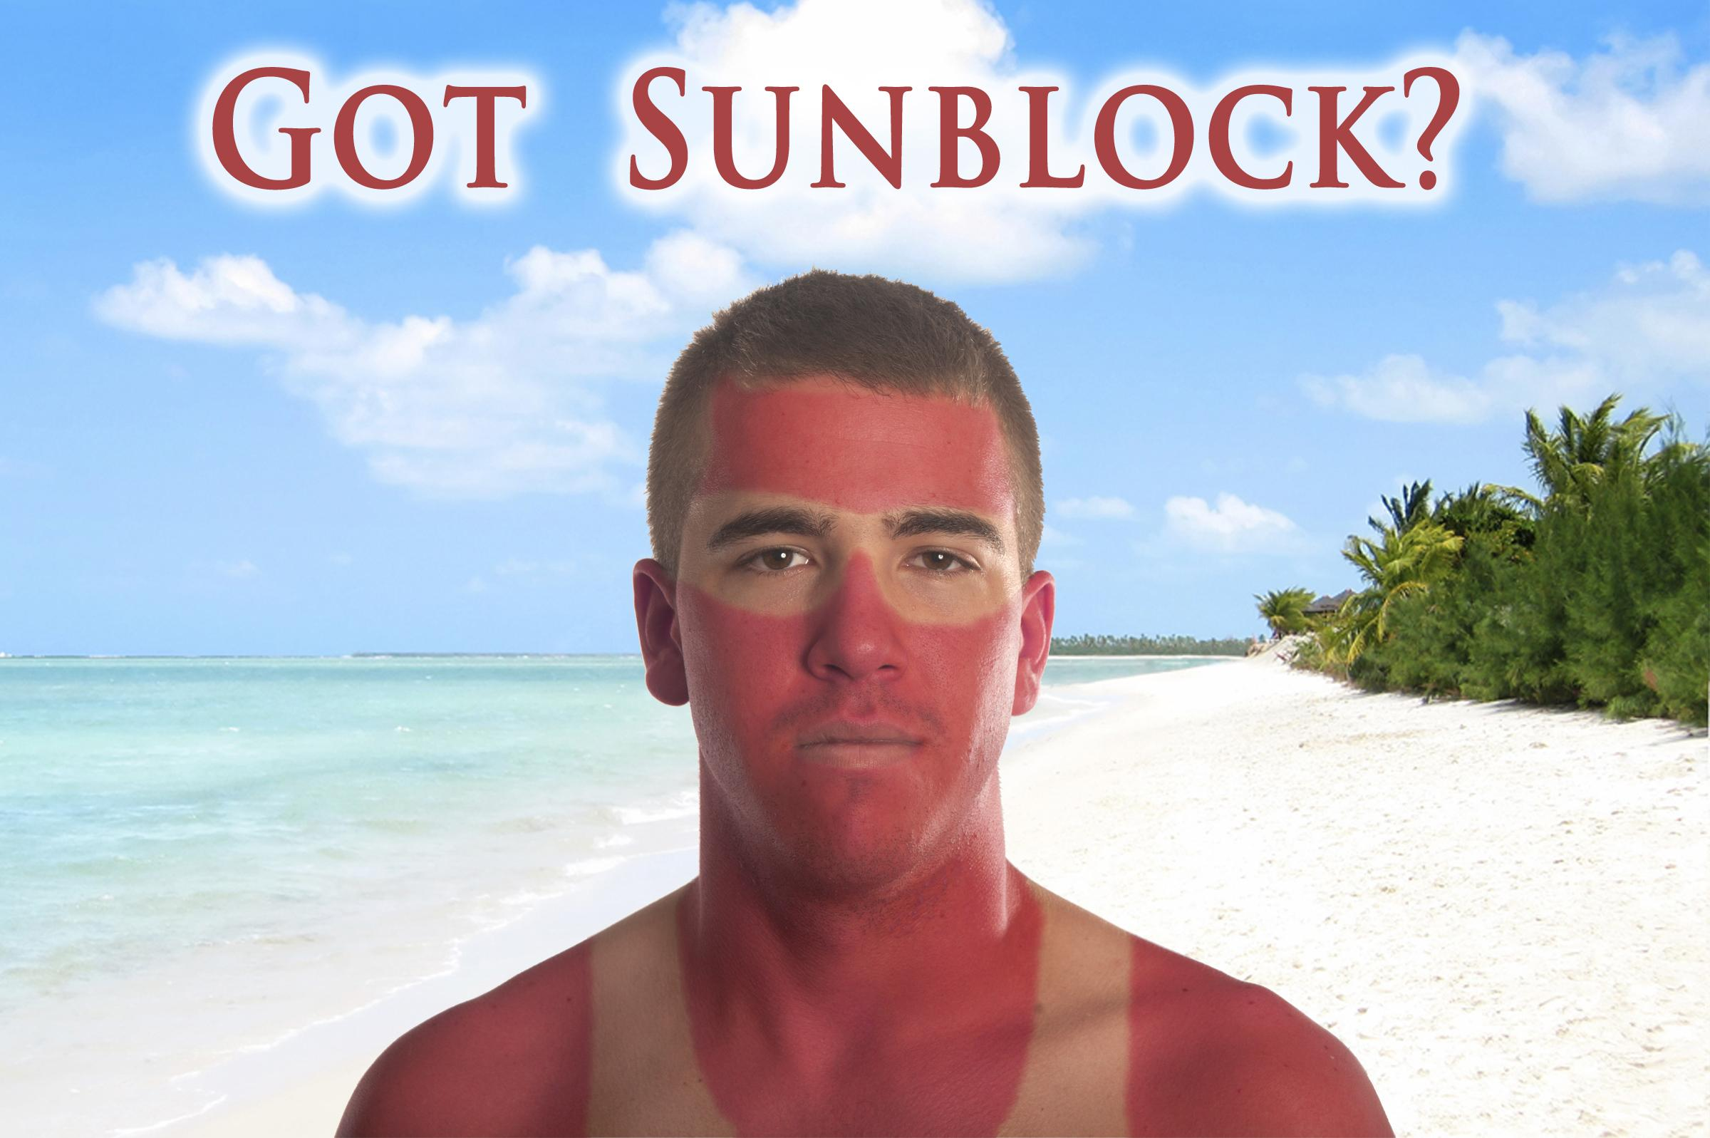
Sunscreen
How does sunscreen protect our skin?
It acts like an invisible bulletproof vest, stopping the UV rays before they can reach the skin and cause sun damage
They can reflect or absorb UV rays, but need to be reapplied to remain effective
Tip: Use broad spectrum sunscreen with SPF (sunburn
protection factor) of at least 30, and reapply every TWO
hours to prevent sun damage
Notes:
(Read slide)
If someone wears sunscreen and still got a sunburn, there are 2 reasons why that might have happened:
First, they might not have used enough sunscreen. There is no such thing as too much sunscreen!
And second, they might have forgotten to reapply their sunscreen after 2 hours. So always remember to reapply!

Slide 12
No Sunscreen
No problem
Avoid sun exposure between 10 am and 4 pm, when the sun’s rays are the strongest
Protect yourself with long sleeves, pants, sunglasses and a wide brimmed hat
Find some shade! Take a break from the sun by finding a shaded area you can go to
Notes:
(Read Slide)
If you don’t have sunscreen with you, there are still lots of things you can do to protect yourself from the sun!
(Most students will not have brought sunscreen with them to school, so it is important for them to know how they can still protect themselves)

Slide 13
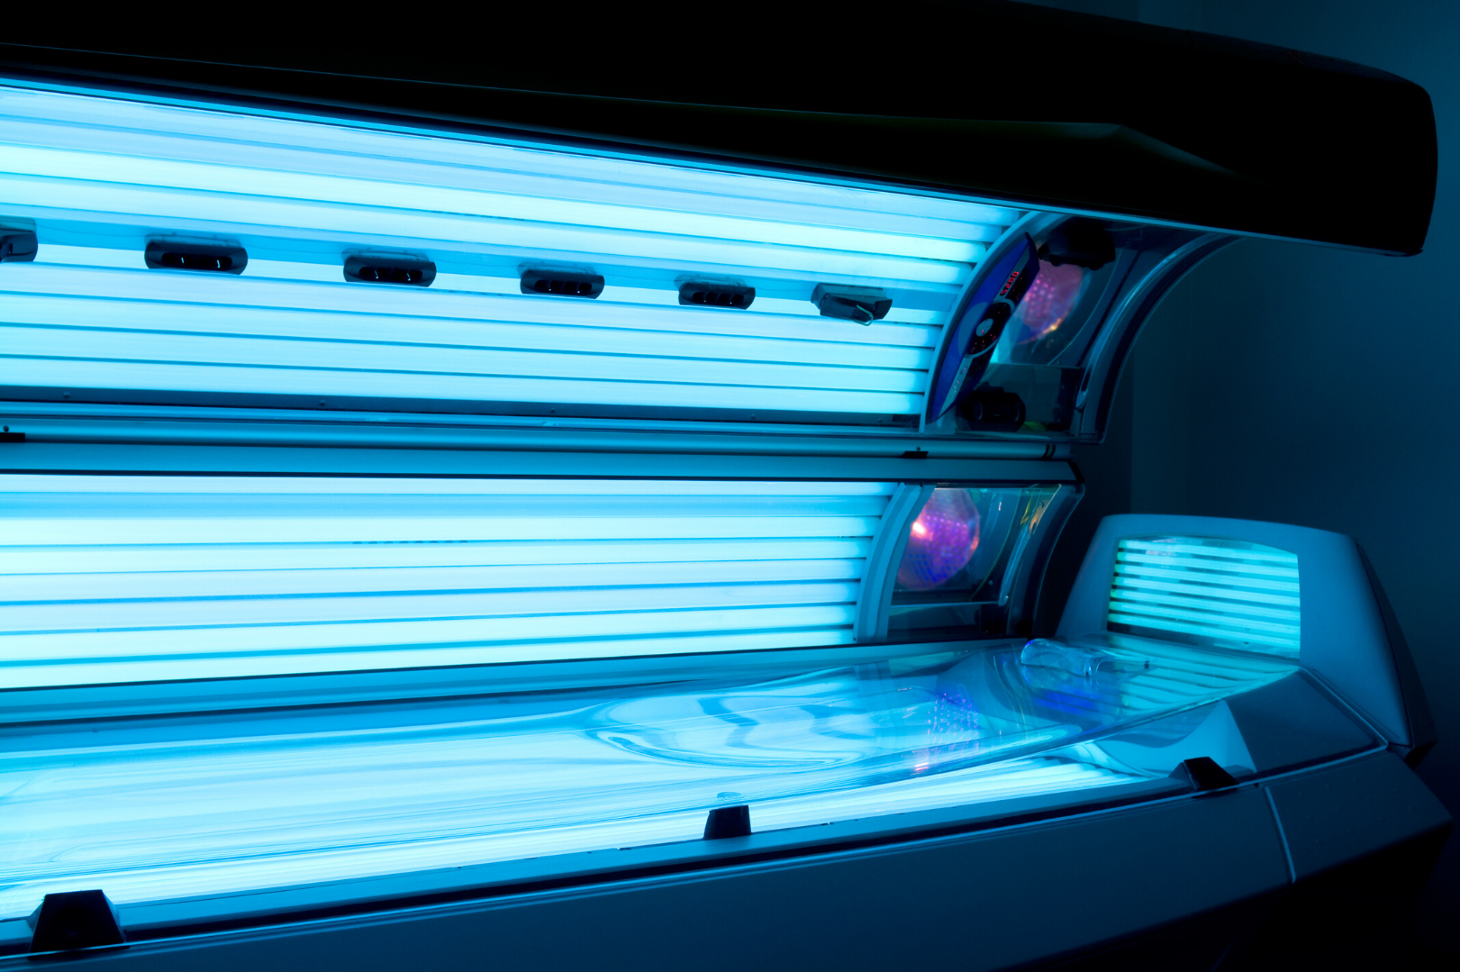
Tans and Tanning Beds
Are tans healthy?
No, a tan is a sign of damaged skin cells
Tanning Beds
The lightbulbs have both UVA and UVB rays
They increase your chance of getting
skin cancer by 75%
Notes:
Are tans healthy? No, they are a sign of damaged skin cells.
So are tanning beds a good idea? Absolutely not.
When you enter a tanning bed, you will have light bulbs above you and below you. These light bulbs have both UVA and UVB rays, both of which are linked to skin cancer.
Using a tanning bed before you’re 35 increases your risk of developing skin cancer by 75% after using it only one time! So I hope you can all choose to never ever EVER go into a tanning bed.

Slide 14
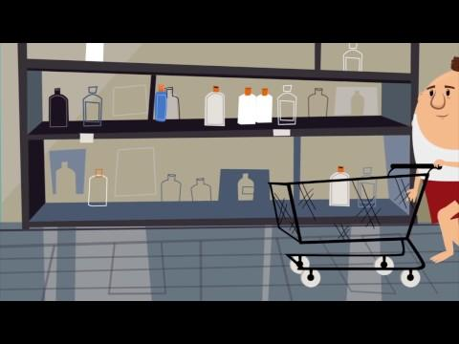
Why Sunscreen?
Notes:
(Introduce the video)
This video will talk more about sunscreen and how it works. It will also explain how UV rays affect our skin.
(Mute yourself during the video to prevent echoing or feedback from audio)
(Youtube link in case closed captioning is needed https://www.youtube.com/watch?v=ZSJITdsTze0&t=2s)

Slide 15
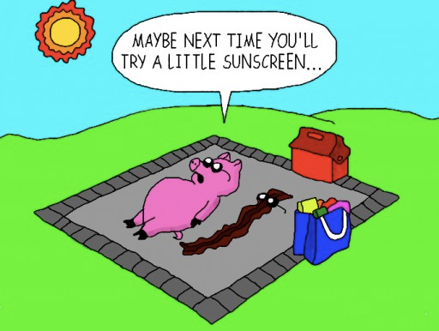
Why Sunscreen?
Notes:
(Transition slide. This is a good chance to ask the students if they have any questions before we move on to the next topic.)

Slide 16
What Are Moles?
Moles are small, dark brown spots and are caused by clusters of melanin
Moles generally appear during childhood and adolescence
Most people have 10 to 40 moles, some of which may change in appearance or fade away over time
New moles as an adult can be a sign of skin cancer and may need to be checked by a doctor
Notes:
(Read slide)
So if you get a new mole as an adult, and this mole looks suspicious, then you will want to get it checked out at the doctor.
So how do we know when a mole is suspicious? (rhetorical question)
(Use the word “Suspicious” instead of “bad” or “cancerous” as it gives children a better understanding that not all moles are skin cancer)

Slide 17
The ABCDE’s of Early Detection
Early detection is important for successful treatment
Check your skin monthly for new moles
Check your whole body including places like your armpits or the bottoms of your feet
© CSCF2013
Notes:
To know which moles are suspicious, we use the ABCDE’s of early detection.
Early detection is important when it comes to skin cancer, because the earlier you catch it, the easier it is to get rid of. In fact, if you find a suspicious mole and you go to the doctor right away, you have a 99% chance of successful treatment. However, if you don’t go to the doctor right away after finding a suspicious mole, and this mole turns out to be skin cancer, you might need surgery or even chemotherapy.
So what we need to do is to check our bodies at least once a month for new moles. We need to check everywhere on our bodies. We check behind our ears, in between our toes, and even our armpits.

Slide 18
A is for “Asymmetry”
Is the shape of the mole different on one side compared to the other?
Regular
Irregular
Symmetrical
Asymmetrical
© CSCF2013
Notes:
If you take the regular mole and fold it in half, both sides will match, meaning it is symmetrical, which means it’s safe.
But, if you take the irregular mole and fold it in half, the two sides wouldn’t match, meaning it is asymmetrical, which is more suspicious.
HOWEVER;
If you have a mole that looks like that, and you’ve had it your whole life and it has never changed, it is still safe.

Slide 19
B is for “Border”
Is the edge irregular or uneven?
Regular
Irregular
Even edges
Uneven edges
© CSCF2013
Notes:
We are looking for even, regular edges like in the first picture, as opposed to the very uneven and irregular edges in the second picture. Those irregular edges make this mole more suspicious.
HOWEVER;
If you have a mole that looks like that, but you’ve had it your whole life and it has never changed, it is still safe.

Slide 20
C is for “Color”
Is there different color variations within the mole?
Regular
Irregular
One shade
Two or more shades
© CSCF2013
Notes:
Moles can be lots of different colors, from a light tan to a dark brown, and even purple. But, as long as they are only one color, they are still safe.
Two different moles on your body can be different colors, but as long as each mole is only one color, they are still safe. (Point to two different areas on yourself show what is being said)
If your mole looks more like the second picture, with two colors or more, that mole is very suspicious and needs to get checked out. Moles are only supposed to be one color.

Slide 21
D is for “Diameter”
Is the mole larger than the eraser head of a pencil (>6mm)?
Regular
Irregular
Less than 6mm
More than 6mm
© CSCF2013
Notes:
We are looking for a diameter of less than 6mm.
We can actually use our pencil eraser to measure. If you put your pencil eraser on top of your mole and it covers the whole thing, it means it is smaller than 6mm, which is safe. But if you put your pencil eraser over your mole and it does not cover the whole thing, it means it’s over 6mm, which is more suspicious.
HOWEVER;
If you have a mole that is bigger than 6mm, but you’ve had it your whole life and it has never changed, it is still safe.

Slide 22
E is for “Evolution”
Look for a change in colour, size, shape
© CSCF2013
Notes:
This is when we look at the moles we have always had.
Let’s say you have a mole that looks like that first picture there. Let’s also say that you are never sun safe; you never wear protective clothing, you never go under the shade, and you definitely never wore sunscreen. Then a couple years later, your mole now looks more like the last picture. It might be bigger, or a different shape, or a different color. Those changes make that mole very suspicious and it needs to get checked out by a doctor”
If you see any changes in your moles in size, shape or colour, definitely get that mole checked out as it could be a sign of skin cancer

Slide 23
Dark Skin
People with darker skin have a harder time finding skin cancer on their skin, and are sometimes diagnosed at a later stage because of this.
If you have darker skin, look for:
Dark spot, growth, or darker patch of skin that is growing, bleeding, or changing in any way
Sore that won’t heal — or heals and returns, or has a hard time healing
Patch of skin that feels rough and dry (and won’t go away)
Dark line underneath or around a fingernail or toenail
Notes:
The last thing to mention is that skin cancer might look different in people who have darker skin.
(Read slide)
Skin cancer in darker skin often develops on parts of the body that get less sun, such as: the bottom of the foot, lower leg, palms and even under a nail.
(Ask if there are any questions about moles or skin cancer before moving on)

Slide 24
True or False?
© CSCF2013
Notes:
(Students can raise their hand if they think it’s true, then raise their hands if they think it’s false.)
(For a class learning from home, you can have the students write down on the chat which one they think is the right answer. If you can’t see the class, simply read the question and allow for 10-15 seconds before giving the answer)

Slide 25
True or False
Dogs can sunburn
True
© CSCF2013
Notes:
True. (Note: when you click next, the answer will pop up)
But, do we put sunscreen on them? No, because they might lick it off, which would hurt their tummies. However, we can help them by making sure they have shade, water and that they stay inside between 10am and 4pm. And if your dog will let you, they can also wear sunglasses and a hat!

Slide 26
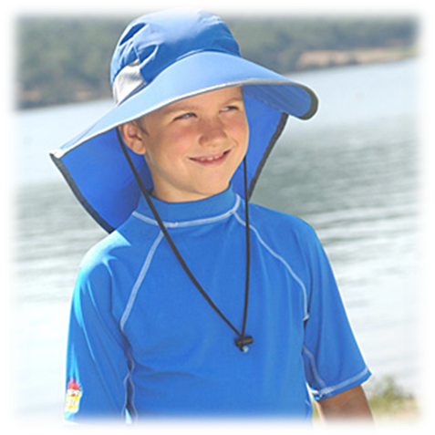
True or False
The type of fabric and the colour of your clothes can make a difference in sun protection
True
© CSCF2013
Notes:
True.
Lighter colors will reflect some sun rays away from your skin. Tighter weaves and thicker fabric, such as jeans, will also offer more protection.

Slide 27
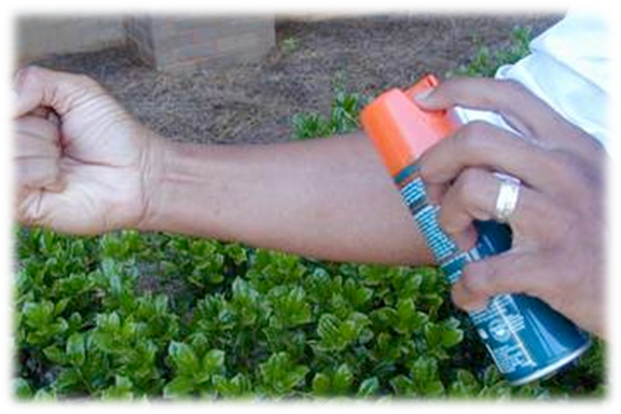
True or False
Some bug-sprays can spray away your sunscreen
True
© CSCF2013
Notes:
True.
You can use both bug spray and sunscreen, but they cannot be applied at the same time. Make sure you apply your bug spray first and wait until it dries before putting on sunscreen.

Slide 28
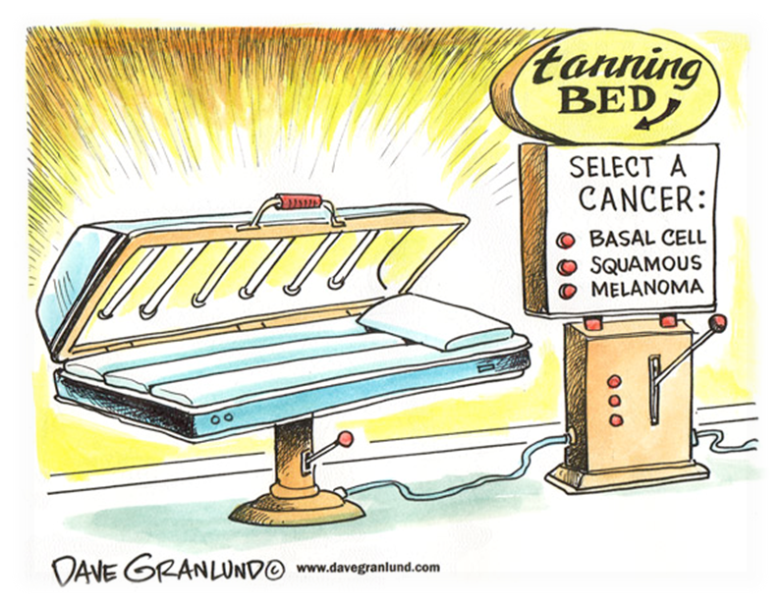
True or False
Tanning beds are safe
False
© CSCF2013
Notes:
False.
Tanning Beds use UVA and UVB light, both linked to skin cancer
The World Health Organization has classified indoor tanning beds to be as bad for you as cigarette smoking and rat poison.
(You can also mention how tanning beds are banned in some countries, such as Australia where skin cancer rates are high)

Slide 29
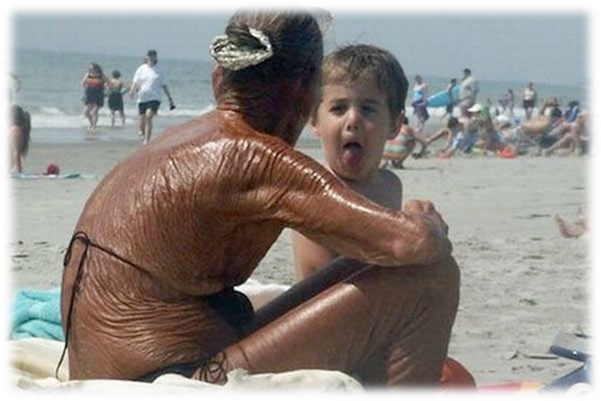
True or False
Having a tan is a good way to prevent sun burns
False
© CSCF2013
Notes:
False.
All tanning is damage to your skin and will not protect you against sunburns as sun damage will not prevent more sun damage.
(Extra info: going out in the sun with a tan is equivalent to wearing sunscreen with an SPF of 3 or 4, which is not even close to enough)

Slide 30
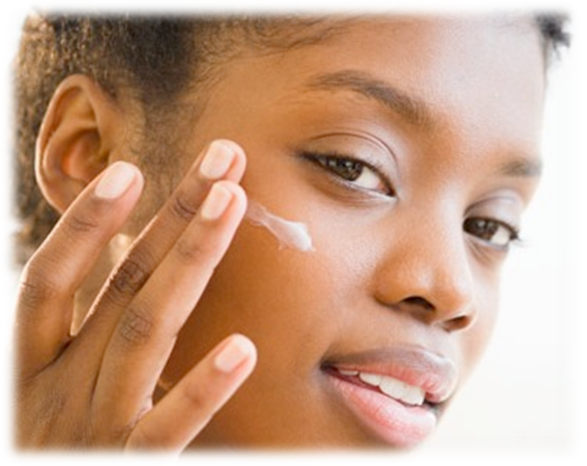
True or False
People with darker skin tones or those who tan easily still need to use an SPF of at least 30
True
© CSCF2013
Notes:
True.
Everyone, no matter their skin colour, should always practice sun safety when they are outside.

Slide 31
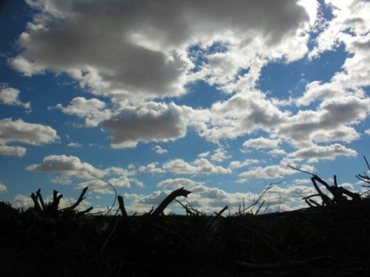
True or False
You don’t get sun damage on a cloudy day
False
© CSCF2013
Notes:
False.
Up to 80% of UV rays can pass through clouds.
In fact, you should be sun safe when you go outside for more than 15 minutes.

Slide 32
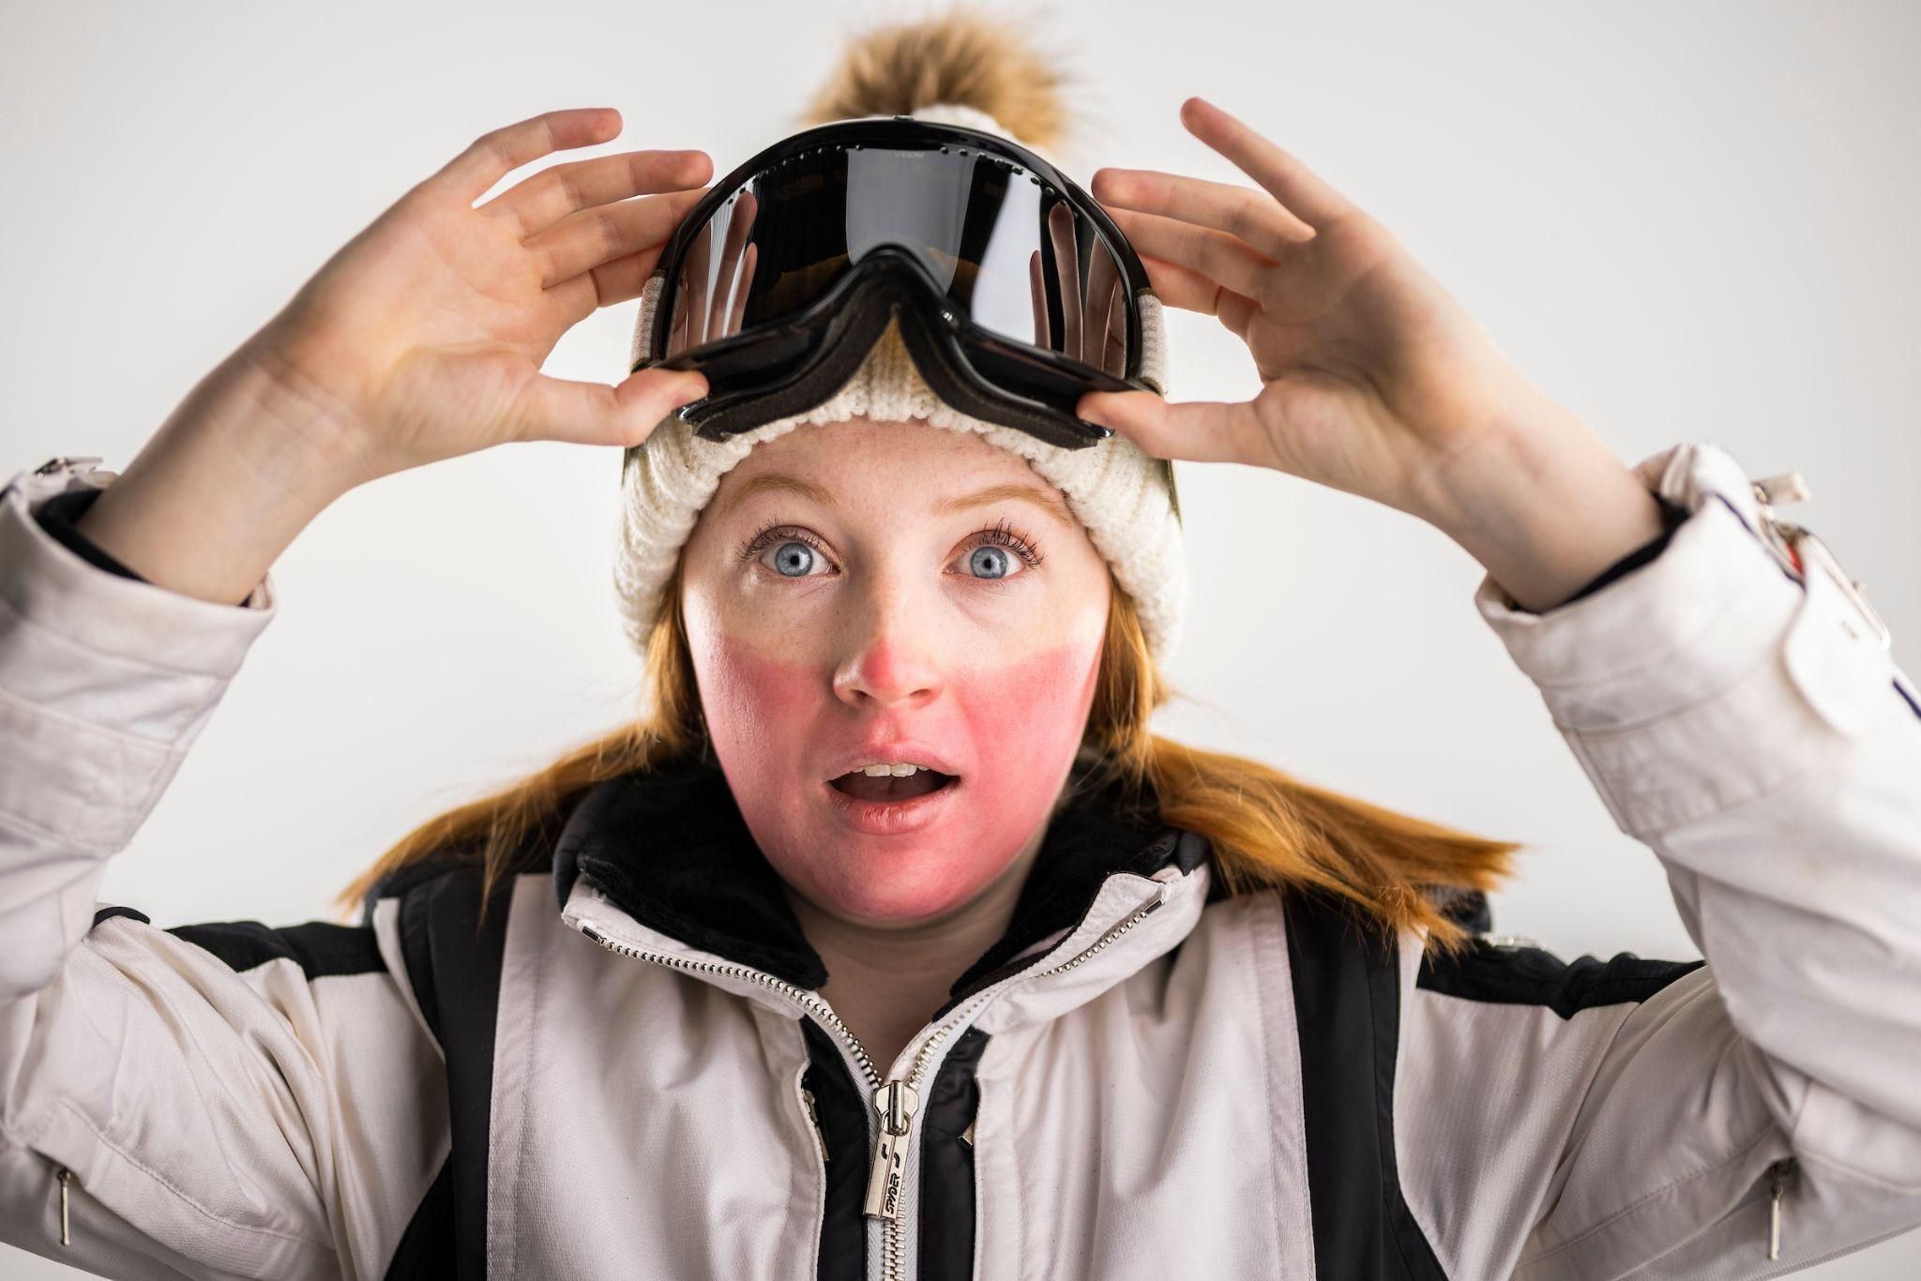
True or False
You don’t need to practice sun safety in the winter
False
Notes:
False.
Snow can reflect up to 90% of UV rays.
In fact, you could get frostbite and a sunburn on the same day. That’s why we need to protect our skin from both the cold and the sun.
(Alternative: The good news is that in the winter, you’re already covering much of your skin because it’s cold out. But you need to remember to protect whatever is left of your skin that is still exposed, usually your face)

Slide 33
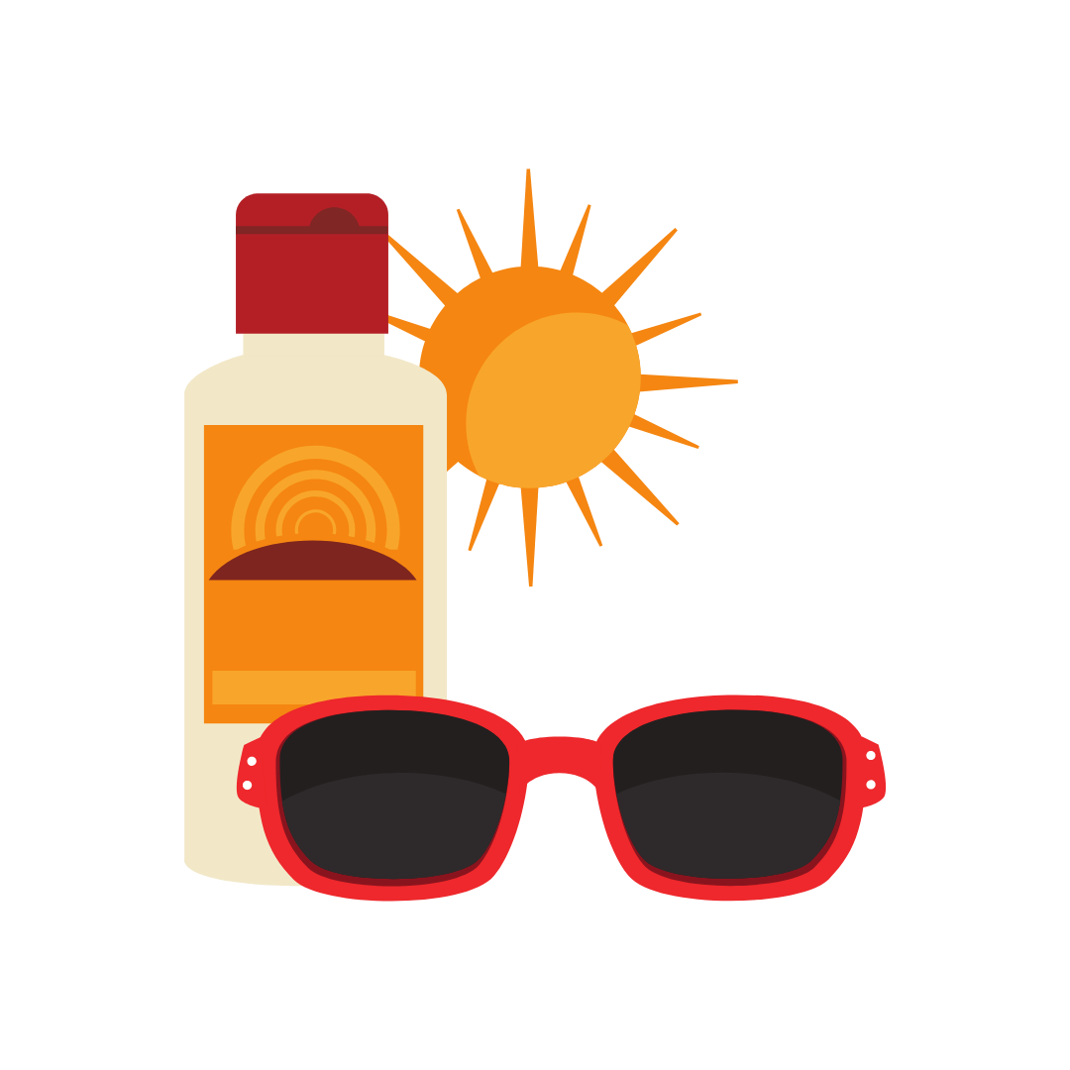
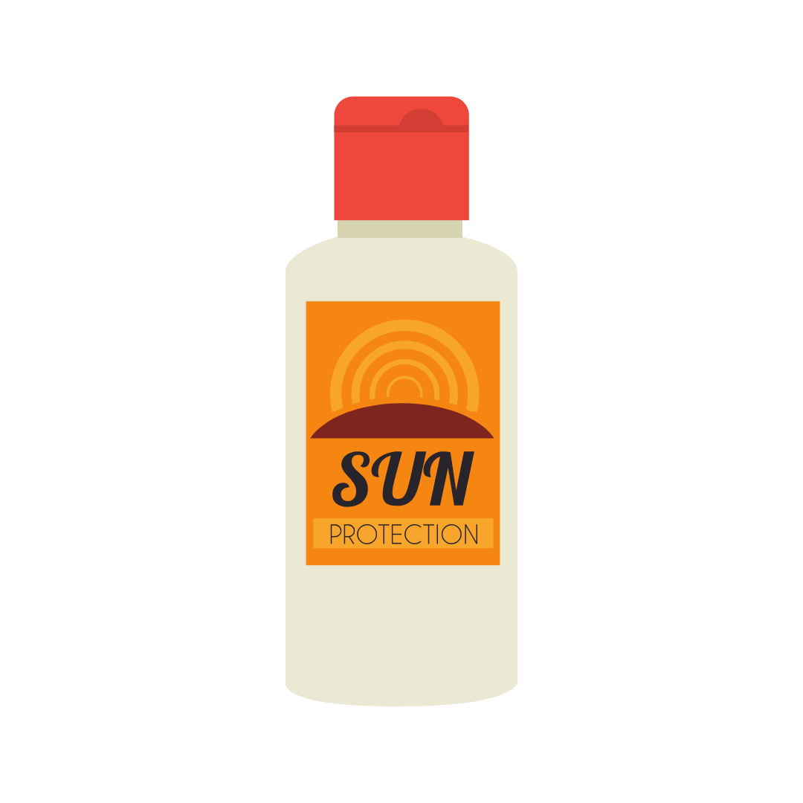
Tips To Protect Yourself
Check your moles at least once a month
Don’t sunbathe or use tanning beds
Avoid sun exposure between 10 am and 4 pm
Protect yourself with long sleeves, pants, sunglasses and a wide brimmed hat
Find some shade!
Use sunscreen with SPF 30 or higher
Notes:
(Read slide)
But we are also looking for sunscreen with SPF 30 and something else… Does anyone remember what that was?
Answer: Waterproof sunscreen! You might think you only need waterproof sunscreen when going swimming, but it’s also for when we are sweating. Waterproof sunscreen will prevent it from rubbing off your skin while sweating.

Slide 34
Questions?
© CSCF2013
Notes:
(Final slide)
Does anyone have any questions?
(If you don’t know the answers to their questions, don’t try to guess. Tell them to ask their parents, google it when they get home or to ask their doctor next time they see them)

Slide 35
Special Thanks
To review what you have learned today go to:
www.canadianskincancerfoundation.com/sun-safety-quiz
@cdnskincancerfd
@CanadianSkinCancerFoundation
© CSCF2013

