Slide 1
Sun Safety Education Program
Grades 6 & 7
© CSCF2013
Notes:
Start by introducing yourself (name, school you go to, etc.).

Slide 2
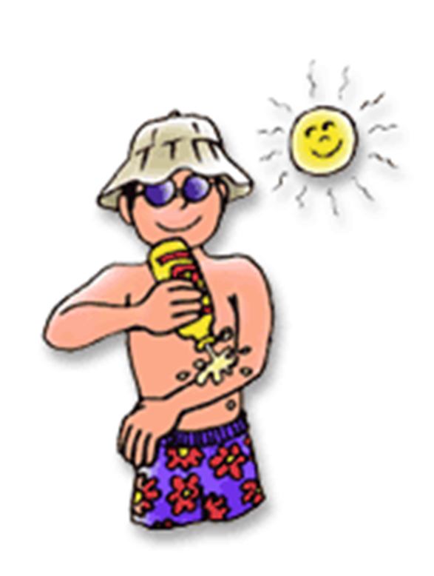
Objectives
What is skin cancer?
Where does it come from?
What can we do to prevent it?
© CSCF2013
Notes:
(Read slide)

Slide 3
What Causes Skin Cancer?
Eczema
Body Lotions
Spray Tans
UV Radiation
Tanning Beds
High Cholesterol
DNA mutations
Microwave
Notes:
Let’s test how much you know already… Raise your hand if you think skin cancer is caused by….?
(Clicking on this slide will show each correct answer as you go through the list. Answers are: UV radiation, tanning beds and DNA mutations)

Slide 4
What is Skin Cancer?
Skin cancer is the abnormal growth of skin cells and it most often develops on skin that is frequently exposed to the sun.
This can happen to people regardless of skin color, and can still happen on areas of the body not often exposed to the sun.
Notes:
(Read slide)

Slide 5
Who Is Most At Risk?
People with lighter skin tones, blond or red hair, blue eyes and freckles are most at risk;
People who have more than 50 moles on their bodies;
People who burn instead of tan;
People who have a family history of skin cancer.
Despite this, people of all skin types are at risk of developing skin cancer.
Notes:
(Read Slide)
However, something that people most at risk have in common is that they have less melanin.
(If you can communicate with the class, you can ask if anyone knows what melanin is)

Slide 6
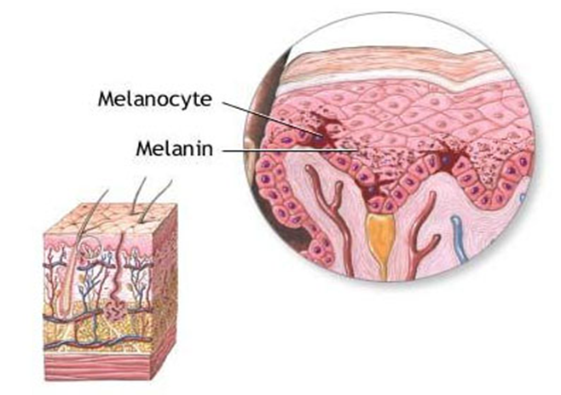
Melanin
Melanin is a substance in your body that produces hair, eye and skin pigmentation. The more melanin you produce, the darker your eyes, hair and skin will be.
Melanin absorbs harmful UV (ultraviolet) rays as it tries to protect your cells from sun damage. This can cause your skin to tan.
However, having a tan means that damage has already occurred.
Melanin alone is not enough to protect your skin from the sun!
Darker skin does not mean you are immune to UV rays.
Notes:
(Read slide)
Those who have darker skin might not get as many sunburns, but they are still vulnerable to the kind of sun damage that promotes skin cancer.

Slide 7
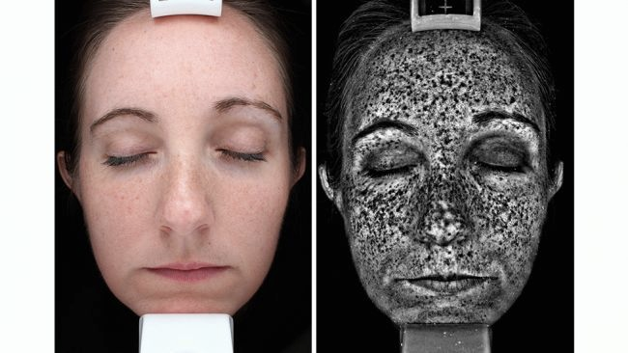
Why Is Sun Safety Important?
The sun’s UV rays can cause sun damage that can lead to DNA mutations, which turn into skin cancer.
While sunburns can heal, sun damage can cause invisible scars in your skin that are permanent.
Notes:
(Read slide)
The more damage that you have, the more likely it is that you could have skin cancer in the future. This is why we try to prevent the damage, as it cannot be erased once it has occured.
Sun damage is not always so obvious.
In the first picture, you can see this lady does not have a sunburn or a tan, so you might think she doesn’t have sun damage. However, the second picture shows where damage has already occurred. So, just because you don’t see it doesn’t mean it’s not there.
However, having sun damage does not mean you will definitely get skin cancer; it only means you are more at risk.

Slide 8
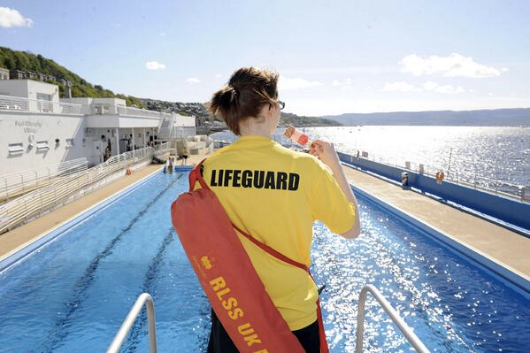
Who Else Is At Risk?
People who spend long periods of time in the sun
Outdoor workers
Outdoor hobbies
People who have had more than 5 severe sunburns,
People who have previously had skin cancer,
Older people, as they have spent more time under the sun.
© CSCF2013
Notes:
People who spend a lot of their time outside are more at risk. This includes outdoor workers and people who have outdoor hobbies. In terms of jobs, we can safely assume that a construction worker would be more at risk than an office worker.
Also at risk are people who have had more than 5 severe sunburns, people who have had skin cancer before, and older people, as they have spent more time under the sun than those of us who are younger.

Slide 9
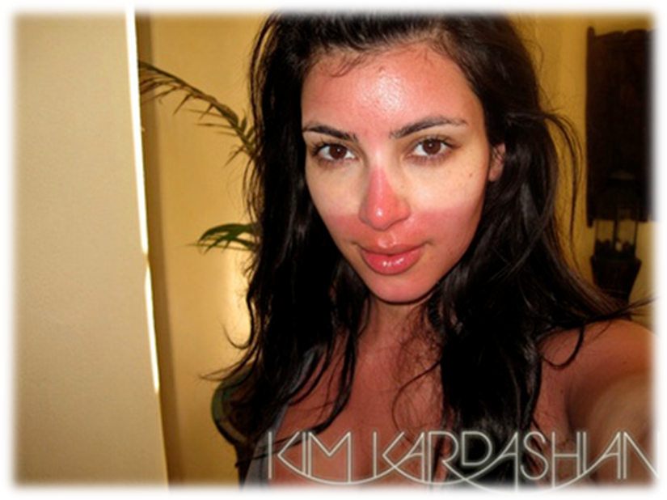
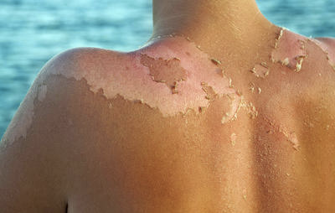
Sun Damage
What are the signs of sun damage?
Redness on skin which is caused by blood vessels expanding to increase blood flow and bring immune cells to the skin to help it heal
Skin peeling off as the body tries to rid itself of damaged cells
© CSCF2013
Notes:
Raise your hand if you’ve ever had a sunburn?
You might be familiar with how they look like, red skin that eventually starts to peel, but let's talk about why that happens. Now, the redness of your skin is caused by the blood vessels in affected areas expanding to increase blood flow and bring immune cells to the skin to help it heal.
When your skin peels off it’s because that’s how your body tries to get rid of damaged cells. However, as we know, some of the damage done is permanent.
For those of you who’ve had sunburns, were they painful? Sunburns can be very painful which is another reason why we want to avoid them.

Slide 10
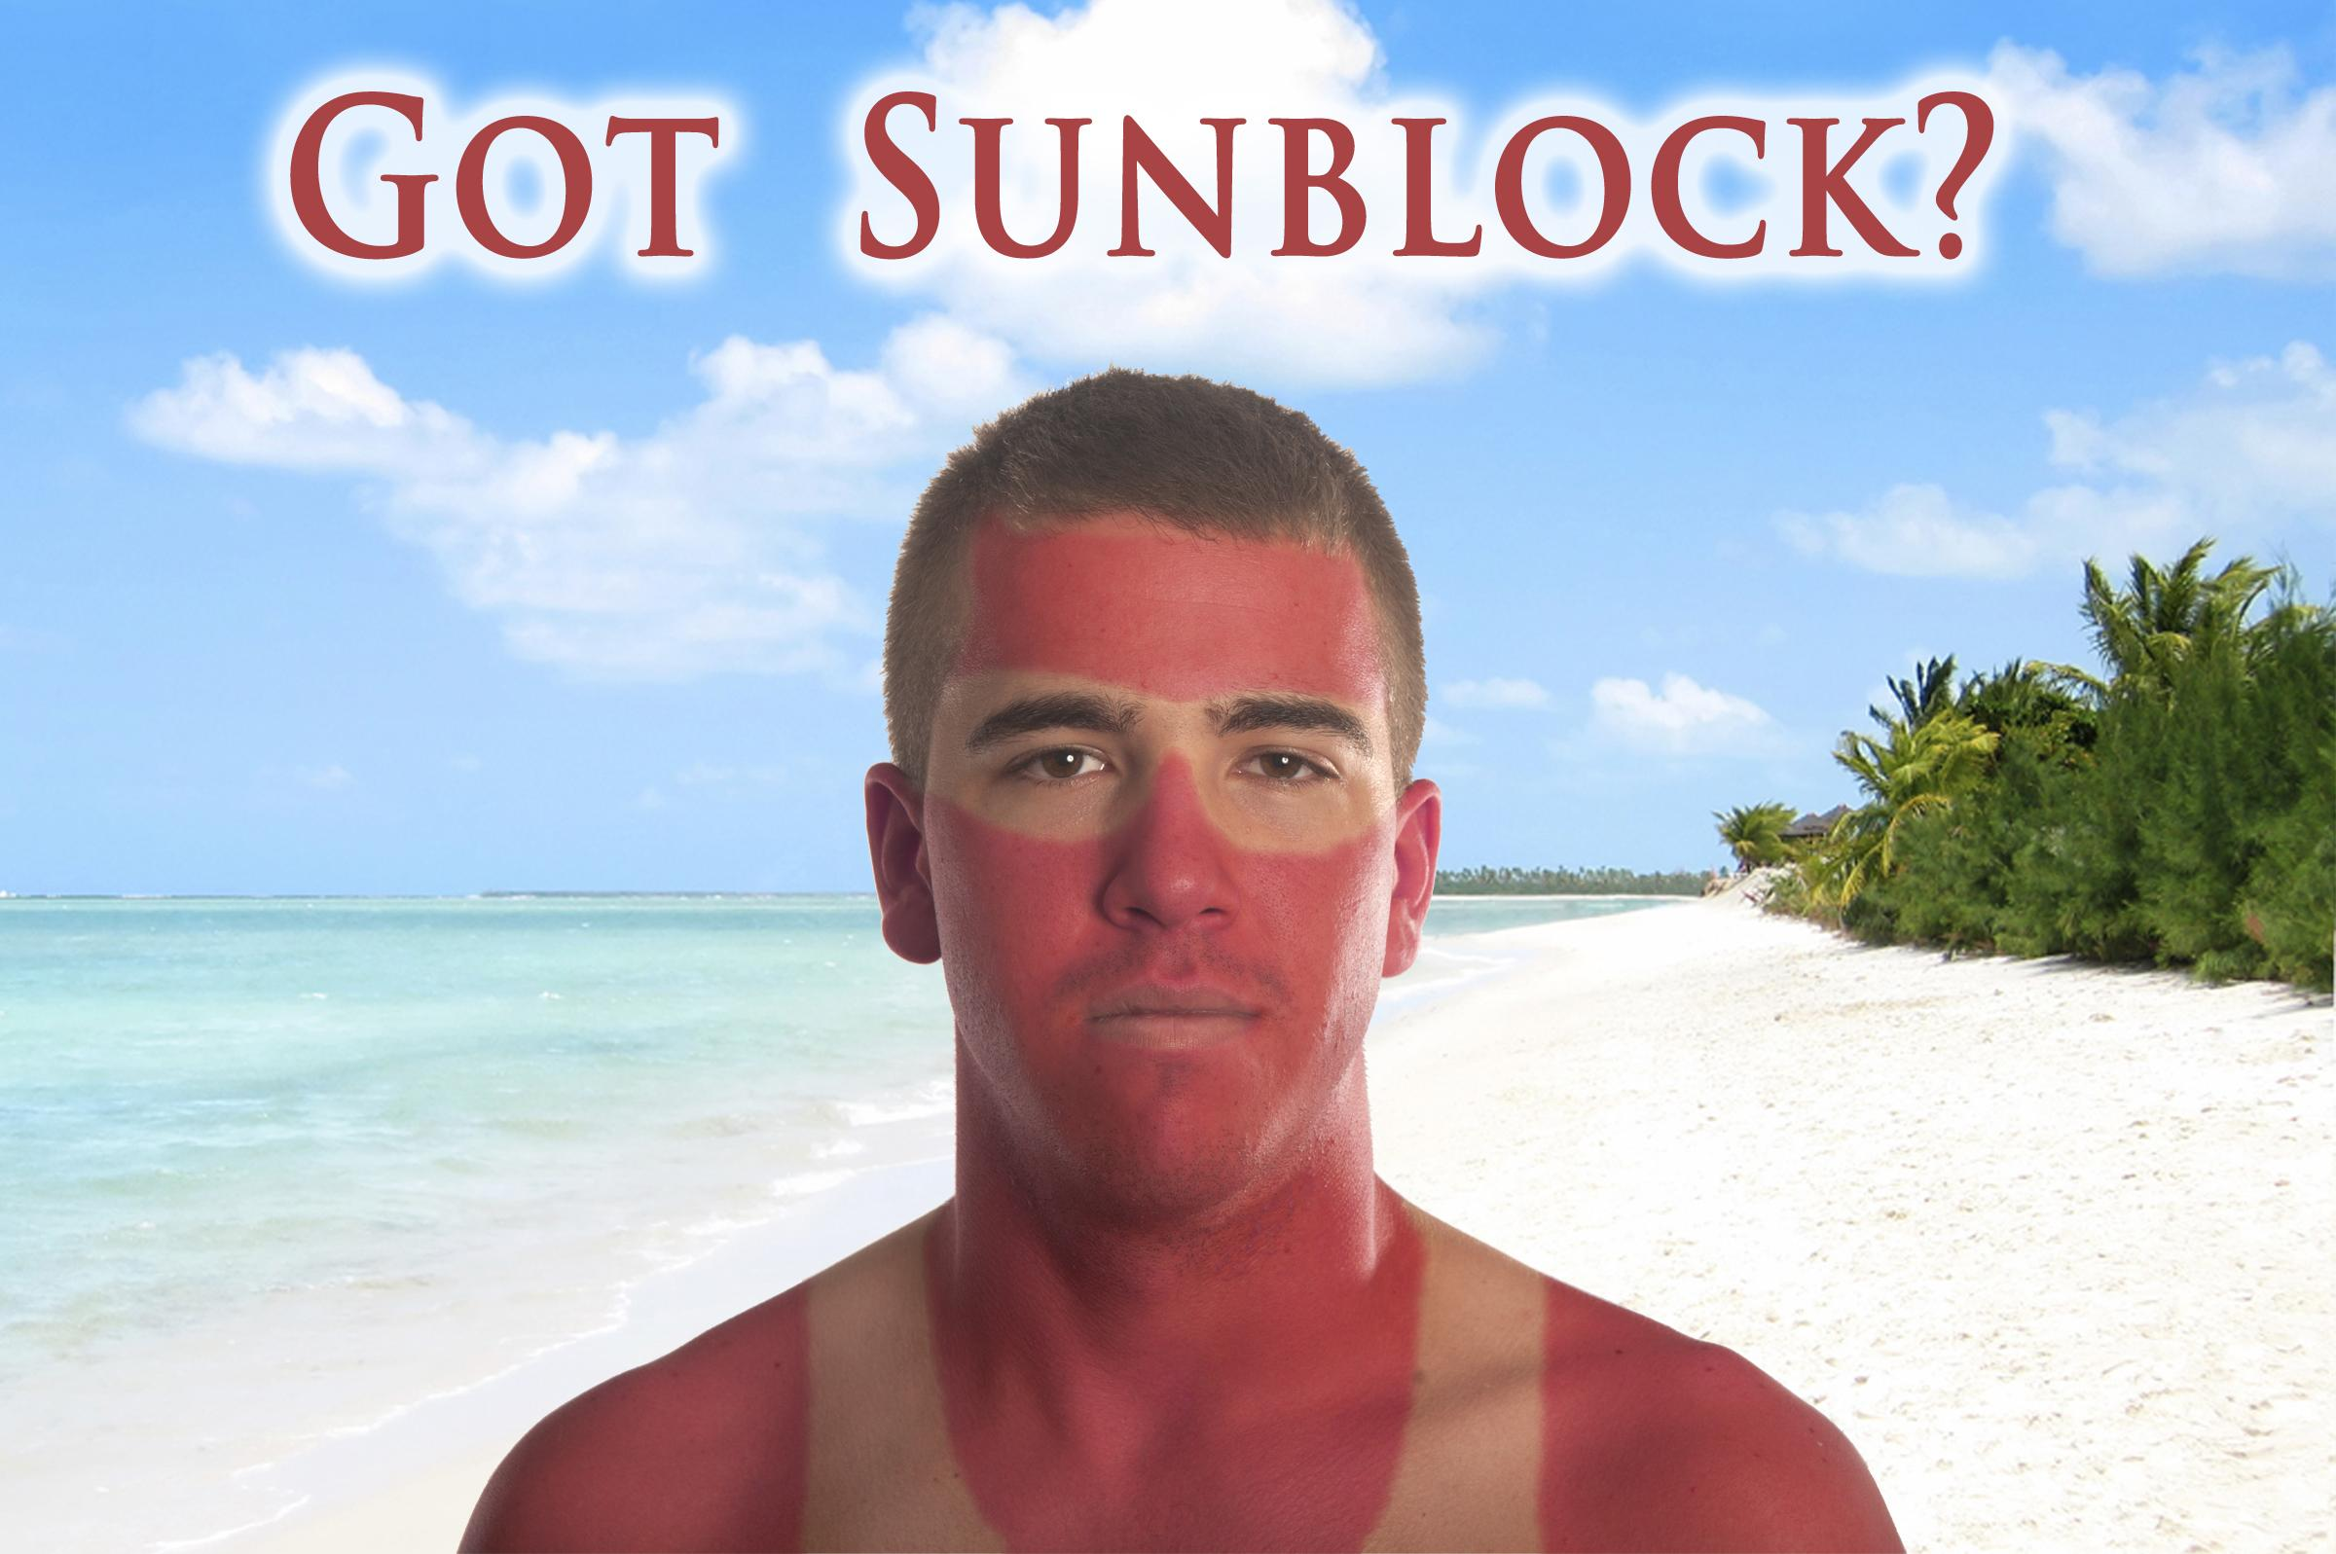
Sunscreen
The active ingredients in sunscreens prevent the sun's ultraviolet (UV) radiation from reaching the deeper layers of the skin.
There are two types of sunscreen:
Physical blockers, which reflect UV rays,
Chemical blockers, which absorb UV rays.
Both need to be reapplied every 2 hours to remain effective.
Tip: Use broad spectrum sunscreen with SPF (sunburn protection factor) of at least 30, and use waterproof sunscreen when swimming or sweating.
Notes:
Now the first thing that comes to mind to prevent sunburns is sunscreen.
(Read slide)
If someone wears sunscreen and still got a sunburn, there are 3 reasons why that might have happened:
First, they might not have used enough sunscreen. There is no such thing as too much sunscreen. Always apply about 1 oz of sunscreen any time you go outside.
Second, they might have forgotten to reapply their sunscreen after 2 hours. Sunscreen becomes less effective overtime.
And lastly, they might have used sunscreen that had expired. Always discard sunscreen after it has expired, or if it has changed in color or smell.

Slide 11
No Sunscreen
No problem
Avoid sun exposure between 10 am and 4 pm, when the sun’s rays are the strongest
Use sun protective clothing, such as long sleeves, pants, sunglasses and a wide brimmed hat
Stay in the shade under an umbrella, tree, or other type of shelter
Notes:
If you don’t have any sunscreen, there are still things you can do to prevent sun damage.
(Read Slide)
Fun Fact: The best type of sun protection is simply to stay out of the sun!

Slide 12
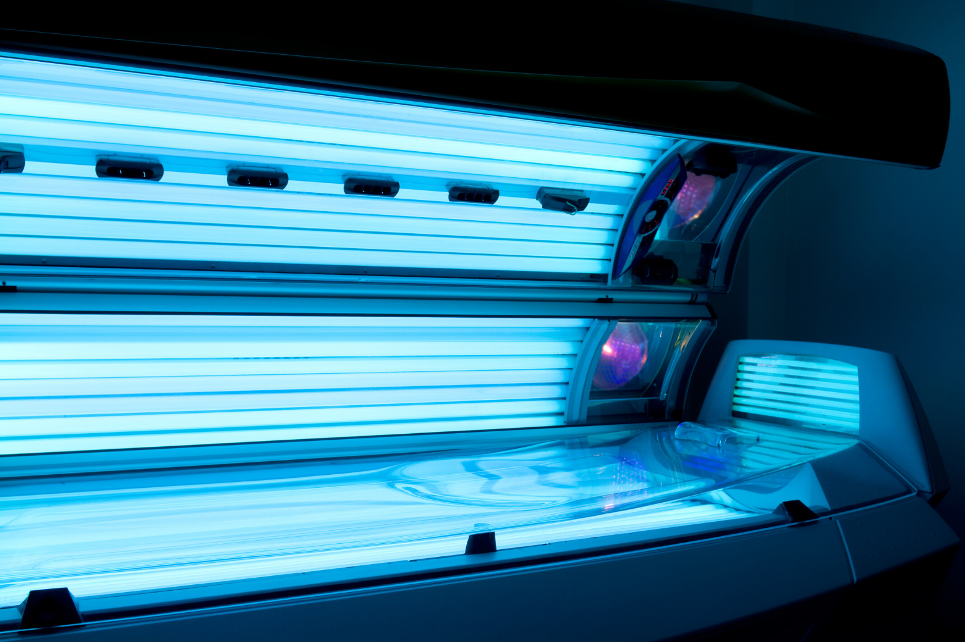
Tans and Tanning Beds
Are tans healthy?
No, a tan is a sign of damaged skin cells.
Tanning Beds:
The lightbulbs have both UVA and UVB rays
They increase your chance of getting skin cancer by 75% if you use them before the age of 35.
The media might claim health benefits to tanning and tanning beds, sometimes calling tans a “healthy glow,” but none of the benefits outweigh the risks to your health.
Notes:
(Read Slide)
(Extra info about tanning beds: UV rays from tanning bed light bulbs are much stronger than UV rays from the sun, which is what makes them more dangerous. 20 minutes in a tanning bed is equivalent to 2 hours out in the midday sun without protection).
(Extra info about sun safety and the media: When googling pictures of sunscreen, 99% of the pictures show people at the beach. This reinforces the idea that you should only wear sunscreen to the beach. The truth is that you should be wearing sunscreen any time you will be outside for more than 15 minutes).

Slide 13
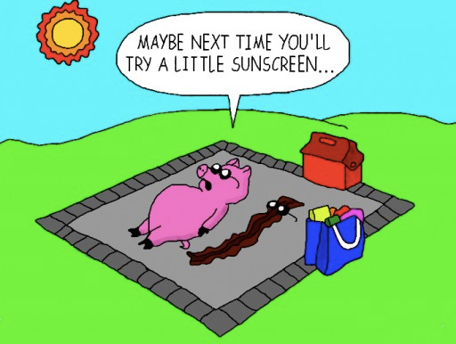
Questions?
Notes:
(Transition slide. This is a good chance to ask the students if they have any questions before we move on to the next topic.)

Slide 14
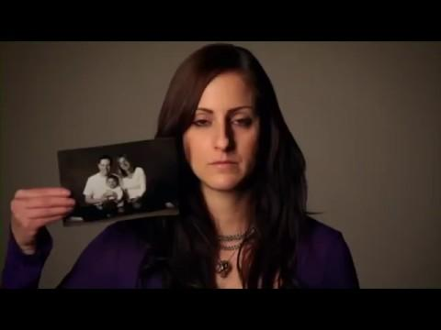
Notes:
(Introduce the video)
This video was made by people who were affected by a type of skin cancer called melanoma, which is a rare but dangerous form of skin cancer. They talk about they wished they had known when they were 16 years old so they could have prevented it.
(Mute yourself during the video to prevent echoing or feedback from audio)
(If students have questions after the video, let them know we will be talking about skin cancer first, and if their question isn't answered, there will be time after for asking questions)

Slide 15
Notes:
Warn students the next few slides have graphic pictures.

Slide 16
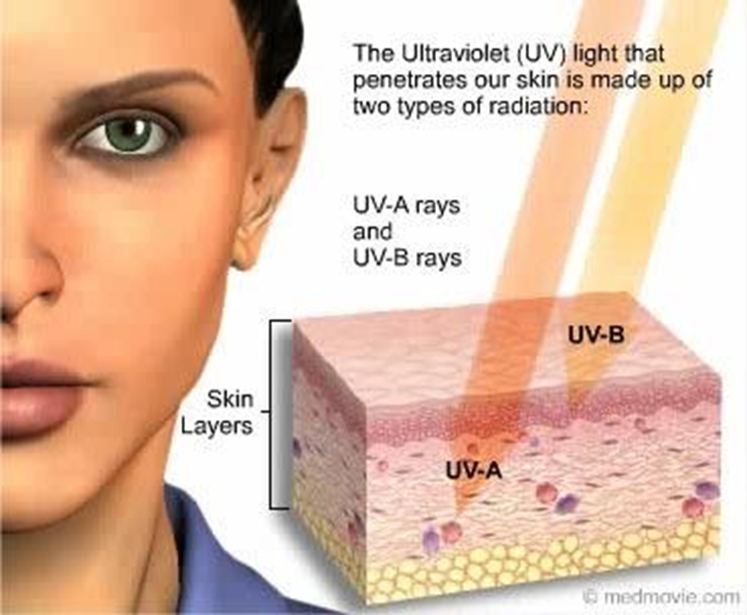
🞂Most common type of skin cancer
🞂Caused by UV radiation from the sun
Notes:
Basal Cell Carcinoma is the most common type of skin cancer, and is caused by UV radiation from the sun.

Slide 17
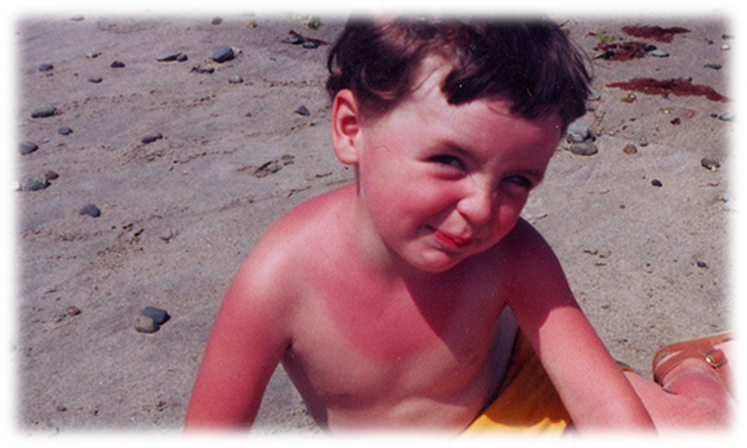
Severe sunburns and intense sun exposure in childhood increase your risk
Usually appear on sun exposed areas
Face and neck
Hands
Notes:
Severe sunburns and intense sun exposure in childhood increase your risk, and they usually appear on areas that are often exposed to the sun, such as your face, neck and hands.
(Warning: there is a picture in the next slide.)

Slide 18
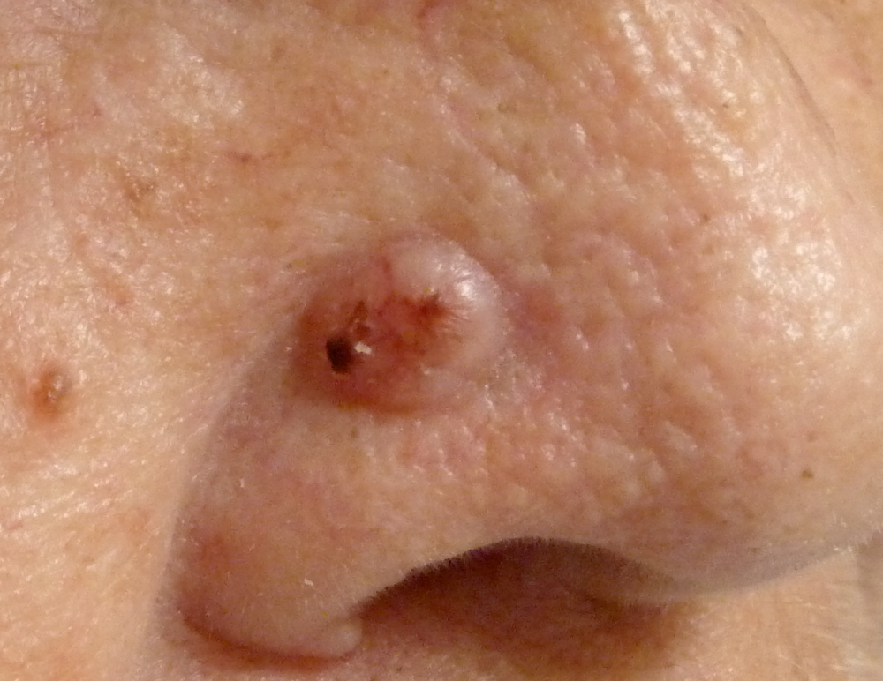
Notes:
Basal cell carcinoma appears as a change in the skin, such as a growth or a sore that won't heal. The good news about Basal Cell Carcinoma is that it is 99% treatable and is rarely fatal.

Slide 19
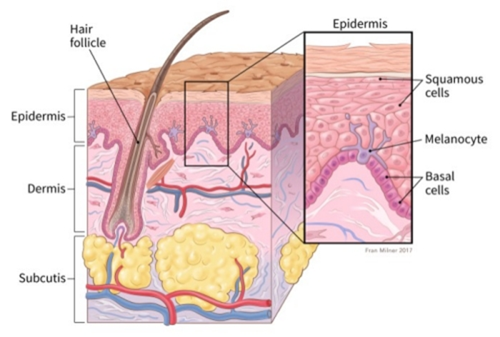
Squamous Cell Carcinoma
2nd most common type of skin cancer
Caused by long-term sun exposure
Appears on sun exposed areas
Head and neck
Hands, arms & legs
Notes:
Squamous Cell Carcinoma is the 2nd most common type of skin cancer, and it is caused by long-term sun exposure (frequent exposure to UV rays). They usually appear on sun exposed areas such as your neck, head, hands, arms and legs.
(Warning: there is a picture in the next slide.)

Slide 20
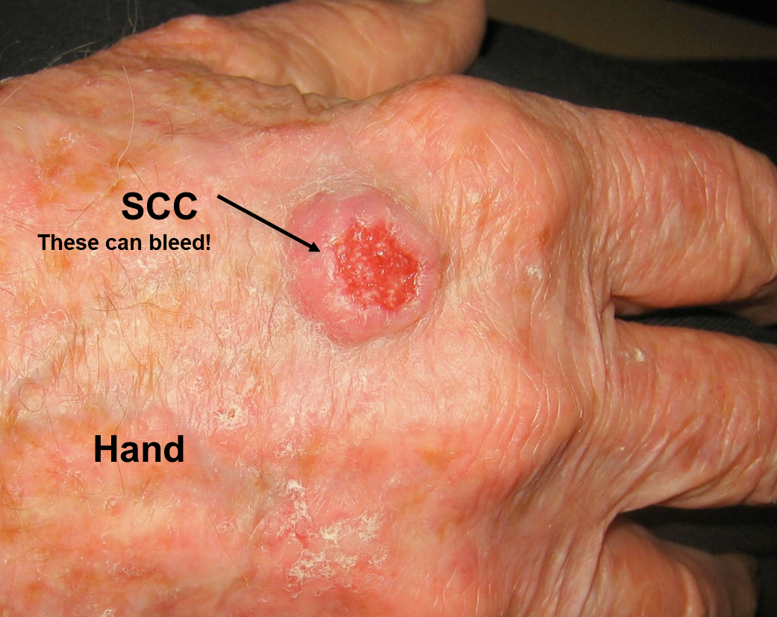
Squamous Cell Carcinoma
Notes:
Squamous cell carcinoma can often look like scaly red patches, open sores, rough, thickened or wart-like skin, or raised growths with a central depression (like in the picture). These can also itch or even bleed. However, just like basal cell carcinoma, Squamous Cell Carcinoma is 99% treatable, especially if you catch them early.

Slide 21
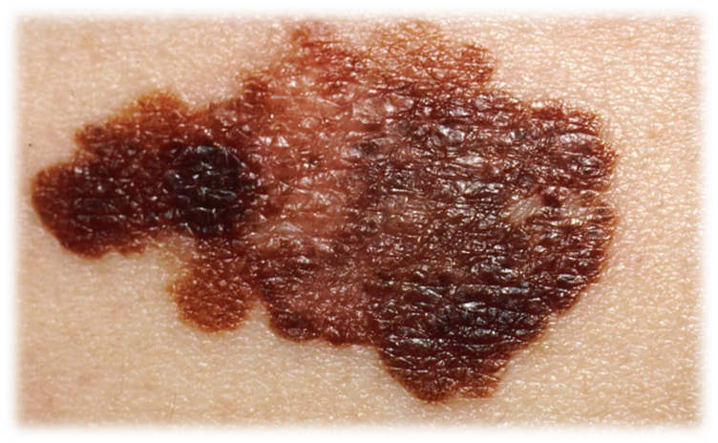
Melanoma
Melanoma is less common, BUT it is the most dangerous form of skin cancer
It is caused by intense sun exposure (often resulting in sunburns)
Melanoma can spread to other parts of your body, such as your liver, lungs or your brain.
Can be treatable if you catch it early!
Notes:
Melanoma is the least common type of skin cancer, and only accounts for about 2% of all skin cancers. However, melanoma is the most dangerous type of skin cancer. This is because melanoma can spread to other parts of your body, such as your liver, lungs, or your brain. It is caused by intense sun exposure, the kind that often results in sunburns.
But even melanoma, as deadly it can be, is treatable if you catch it early. Catching it early would give you a 98% chance of successful treatment. But if you wait 5 years, your chances of successful treatment will drop to 10%.

Slide 22
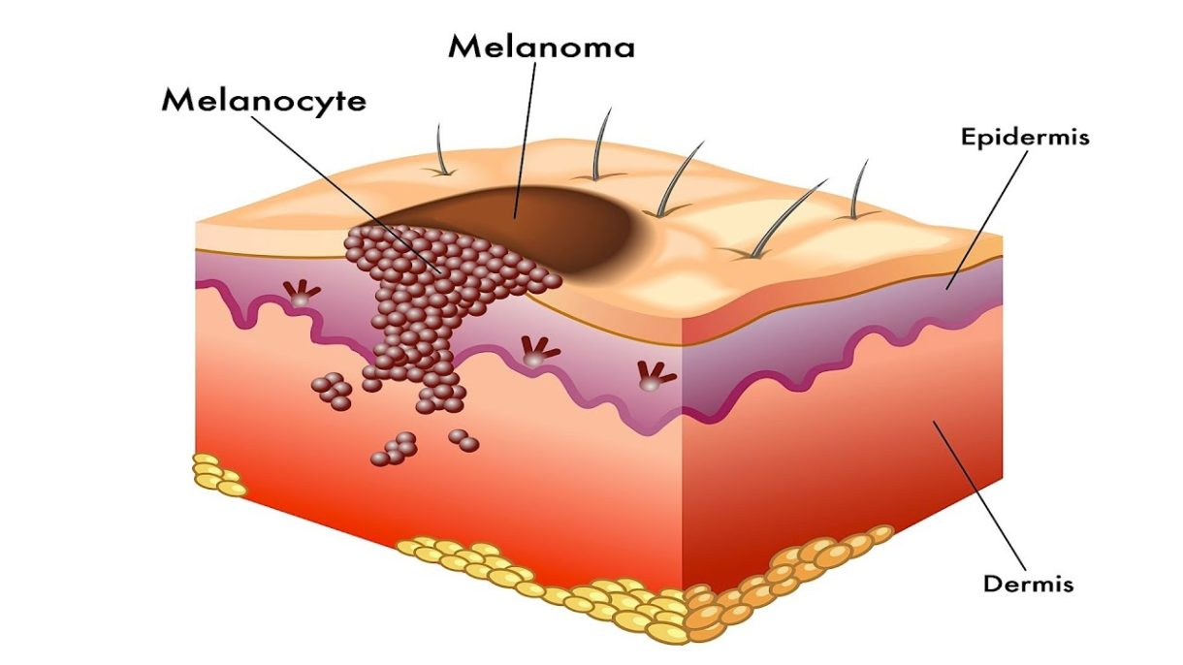
Melanoma
Melanomas are often brown and black in color
Melanomas often resemble moles,
some can even develop from moles
Notes:
Melanomas are often brown and black in colour.
Melanomas can sometimes look like moles, and sometimes DNA mutations can cause moles that we already have to develop melanoma.
So how do we know the difference between moles and melanomas? Well first, we need talk about what moles are.

Slide 23
What Are Moles?
Moles are small, dark brown spots and are caused by clusters of melanin
Moles are common and generally appear during childhood and adolescence
Most people have 10 to 40 moles, some of which may change in appearance or fade away over time
New moles can be suspicious and could be a sign of melanoma and need to be checked by a doctor
Notes:
(Read slide)
So how do we know when a mole is suspicious?

Slide 24
The ABCDE’s of Early Detection
Early detection is important for successful treatment
Check your skin monthly for new moles
Check your whole body including places like your armpits or the bottoms of your feet
Notes:
We use the ABCDE’s of early detection. The ABCDE’s can help you tell which moles are suspicious and need to be checked out by a doctor.
Early detection is important when it comes to skin cancer, because the earlier you catch it, the easier it is to get rid of. Catching melanoma before it spreads might even help you avoid more serious types of treatment, such as surgery or chemotherapy.
So what we need to do is to check our bodies at least once a month for suspicious moles. We need to check everywhere on our bodies. We check behind our ears, in between our toes, and even our armpits.
Now let’s talk about what can make a mole suspicious.

Slide 25
A is for “Asymmetry”
Is the shape of the mole different on one side compared to the other?
Regular
Irregular
Symmetrical
Asymmetrical
Notes:
If you take the regular mole and fold it in half, both sides will match, meaning it is symmetrical, which means it’s safe.
But, if you take the irregular mole and fold it in half, the two sides wouldn’t match, meaning it is asymmetrical, which is more suspicious.
HOWEVER;
If you have a mole that looks like that, and you’ve had it your whole life and it has never changed, it is still safe.

Slide 26
B is for “Border”
Is the edge irregular or uneven?
Regular
Irregular
Even edges
Uneven edges
Notes:
We are looking for even, regular edges like in the first picture, as opposed to the very uneven and irregular edges in the second picture. Those irregular edges make this mole more suspicious.
HOWEVER;
If you have a mole that looks like that, but you’ve had it your whole life and it has never changed, it is still safe.

Slide 27
C is for “Color”
Is there different color variations within the mole?
Regular
Irregular
One shade
Two or more shades
Notes:
Moles can be lots of different colors, from a light tan to a dark brown, and even purple. But, as long as they are only one color, they are still safe.
If your mole looks more like the second picture, with two colors or more, that mole is very suspicious and needs to get checked out. Moles are only supposed to be one color.
Two different moles on your body can be different colors, but as long as each mole is only one color, they are still safe. (Point to two different areas on yourself show what is being said)

Slide 28
D is for “Diameter”
Is the mole larger than the eraser head of a pencil (>6mm)?
Regular
Irregular
Less than 6mm
More than 6mm
Notes:
We are looking for a diameter of less than 6mm.
We can actually use our pencil eraser to measure. If you put your pencil eraser on top of your mole and it covers the whole thing, it means it is smaller than 6mm, which is safe. But if you put your pencil eraser over your mole and it does not cover the whole thing, it means it’s over 6mm, which is more suspicious.
HOWEVER;
If you have a mole that is bigger than 6mm, but you’ve had it your whole life and it has never changed, it is still safe.

Slide 29
E is for “Evolution”
Look for a change in colour, size, shape
Notes:
This is when we look at the moles we have always had.
Let’s say you have a mole that looks like that first picture there. Let’s also say that you are never sun safe; you never wear protective clothing, you never go under the shade, and you definitely never wore sunscreen. Then a couple years later, your mole now looks more like the last picture. It might be bigger, or a different shape, or a different color. Those changes make that mole very suspicious and it needs to get checked out by a doctor”
If you see any changes in your moles in size, shape or colour, definitely get that mole checked out as it could be a sign of skin cancer.

Slide 30
Dark Skin
People with darker skin have a harder time finding skin cancer on their skin, and are sometimes diagnosed at a later stage because of this.
If you have darker skin, look for:
Dark spot, growth, or darker patch of skin that is growing, bleeding, or changing in any way
Sore that won’t heal — or heals and returns, or has a hard time healing
Patch of skin that feels rough and dry (and won’t go away)
Dark line underneath or around a fingernail or toenail
Notes:
The last thing to mention is that skin cancer might look different in people who have darker skin.
(Read slide)
Skin cancer in darker skin often develops on parts of the body that get less sun, such as: the bottom of the foot, lower leg, palms and even under a nail.
(Extra info: Bob Marley, who was a famous Jamaican singer, passed away from a melanoma that was found under the nail of his big toe. He was only 36 years old, which reminds us that melanoma can happen at any age)
(Ask if there are any questions about skin cancer before moving on)

Slide 31
True or False?
Notes:
(Students can raise their hand if they think it’s true, then raise their hands if they think it’s false.)
(For a class learning from home, you can have the students write down on the chat which one they think is the right answer. If you can’t see the class, simply read the question and allow for 10-15 seconds before giving the answer)

Slide 32
True or False
Dogs can sunburn
True
Notes:
True. (Note: when you click next, the answer will pop up)
But don’t put sunscreen on them as it is not dog safe! We can help them by making sure they have shade, water and that they stay inside between 10am and 4pm.

Slide 33
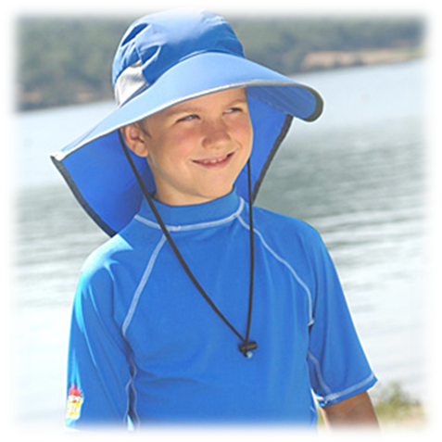
True or False
A wet t-shirt will provide less sun protection than a dry t-shirt
True
Notes:
True.
When wet, the fabric will stretch causing the weave to loosen, which reduces its UPF. A white t-shirt has an UPF of about 7, but once it’s wet the UPF goes down to 5.

Slide 34
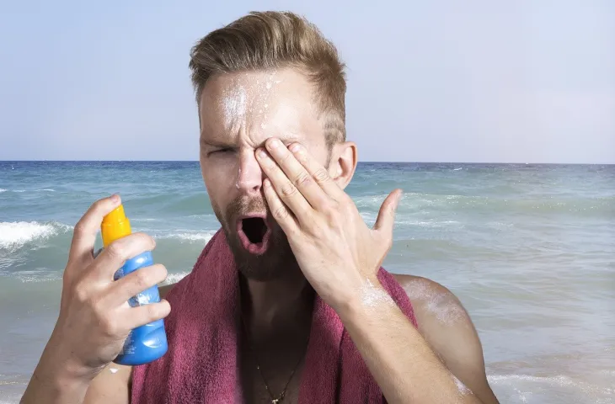
True or False
Spray on sunscreen is less effective than lotion sunscreen
False
Notes:
False.
Spray on sunscreen can be just as effective as lotion sunscreen. For both types of sunscreen, what matters is that you use enough of it. And again, there is no such thing as too much sunscreen!

Slide 35
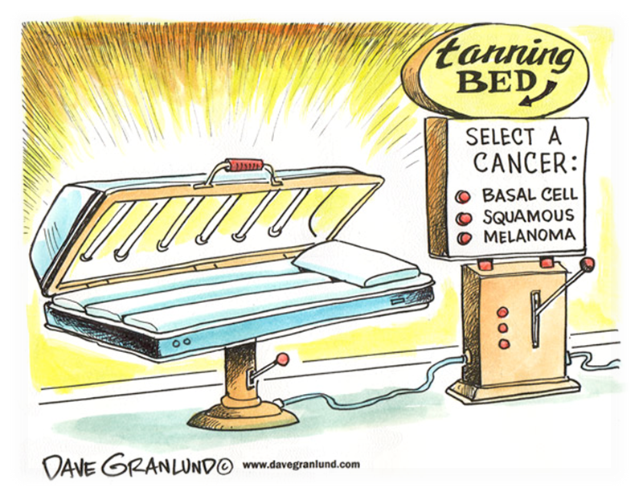
True or False
In Canada, you have to be at least 18 years old to use a tanning bed
True
Notes:
True.
This is because the World Health Organization has classified indoor tanning beds as a class 1 carcinogen along with cigarettes and asbestos.
In some countries, such as Australia, tanning beds are actually illegal, as skin cancer rates are extremely high.

Slide 36
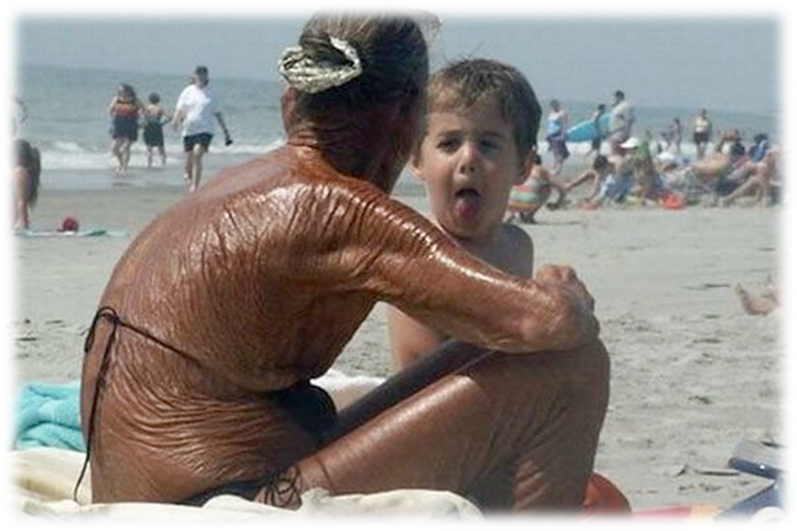
True or False
Having a tan will prevent sunburns
False
Notes:
False.
Going out in the sun with a tan is equivalent to wearing sunscreen with an SPF of 3 or 4, which is not even close to enough to prevent sunburns.

Slide 37
True or False
People with higher levels of melanin still need to use an SPF of at least 30
True
Notes:
True.
Everyone, no matter their skin colour, should always practice sun safety when they are outside.

Slide 38
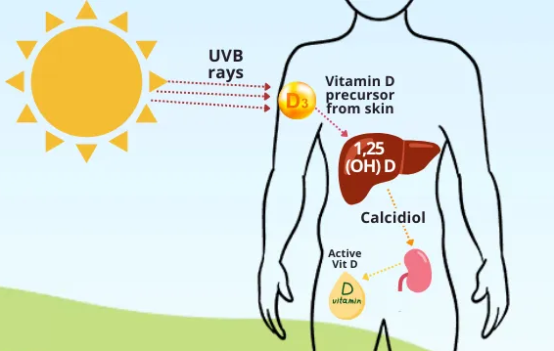
True or False
Wearing sunscreen puts me at risk of developing vitamin D deficiency
False
Notes:
False.
An SPF of 30 filters out about 97 percent of UV rays. This leaves about 3 percent of solar UVB reaching your skin, which can produce Vitamin D. And if you’re still worried, you can always find food that is fortified with Vitamin D.

Slide 39
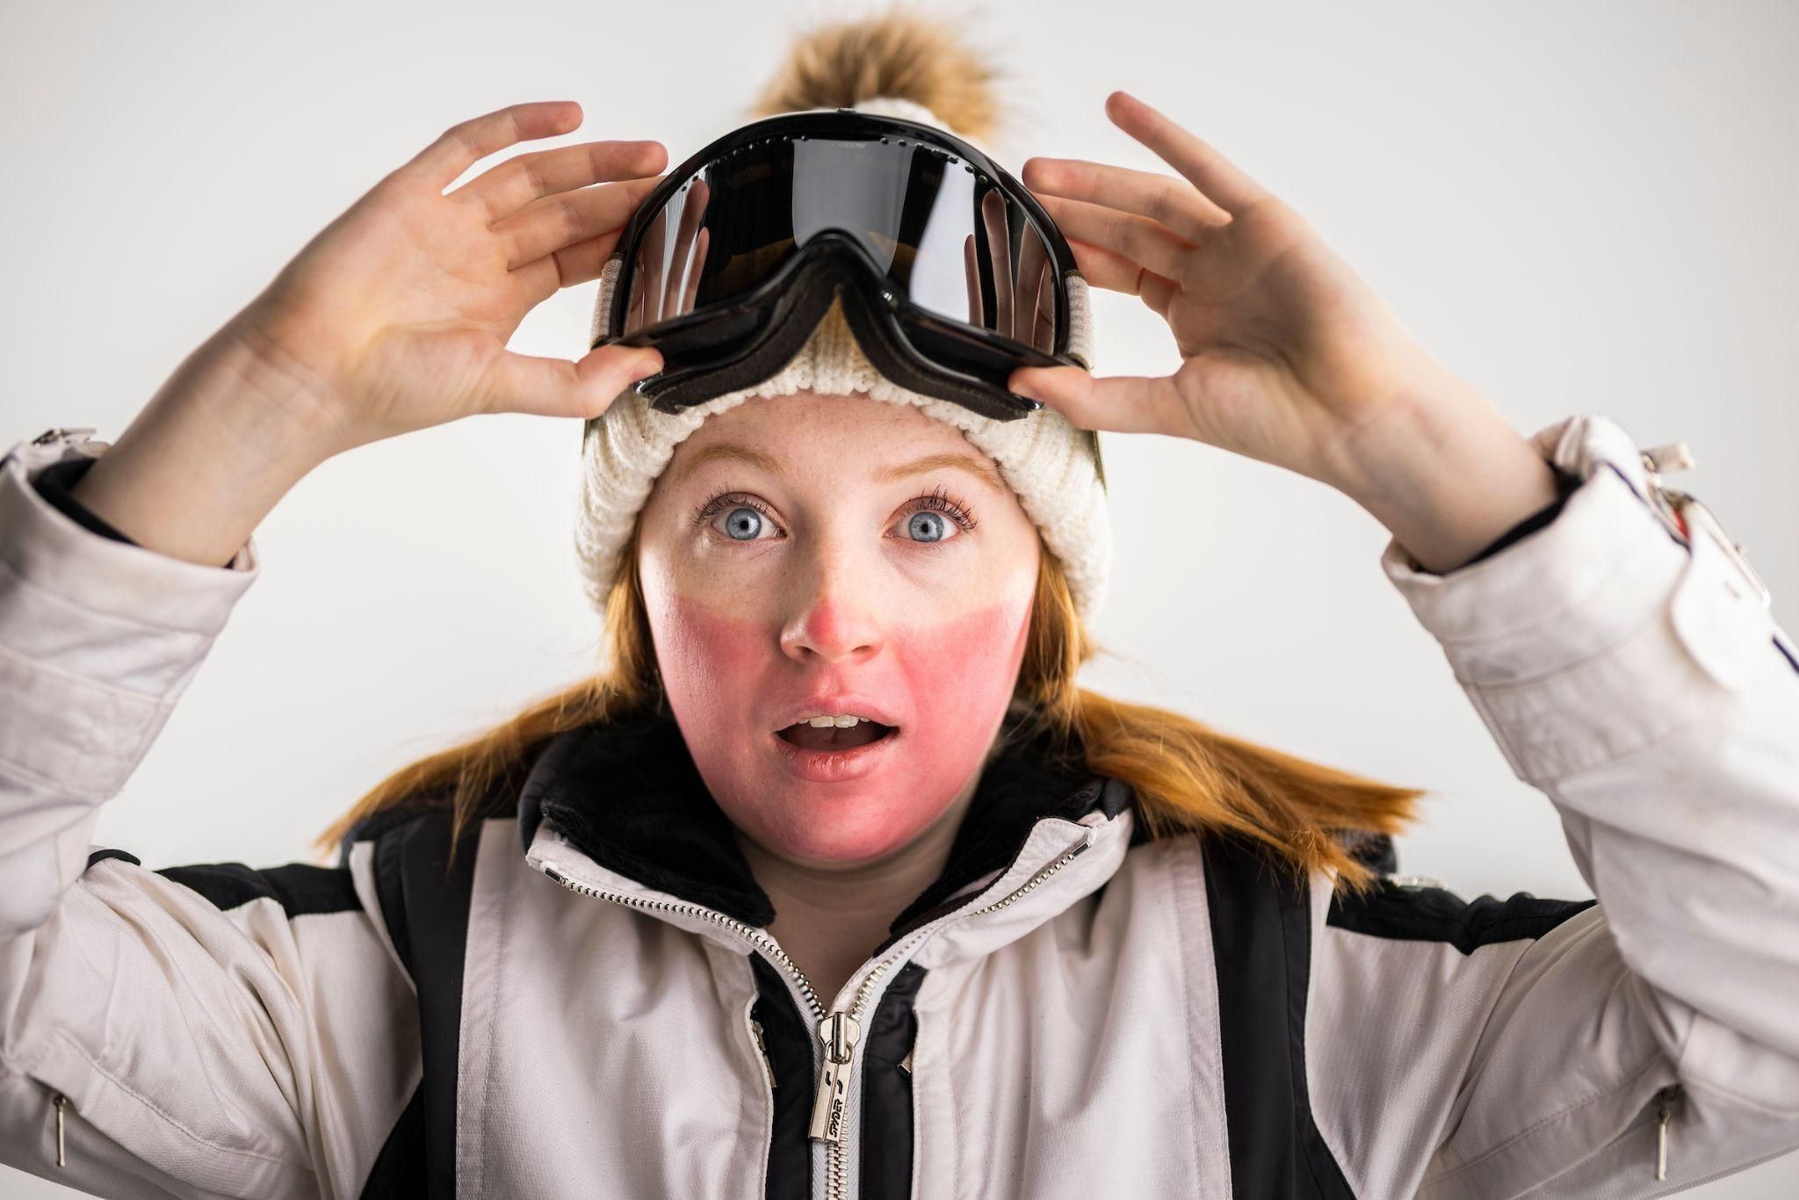
True or False
You don’t need to practice sun safety in the winter
False
Notes:
False.
Snow can reflect up to 90% of UV rays, meaning you get a double dose of UV rays.
In fact, you could get frostbite and a sunburn on the same day.
The good news is that in the winter, you’re already covering much of your skin because it’s cold out. But you need to remember to protect whatever is left of your skin that is still exposed, usually your face.

Slide 40
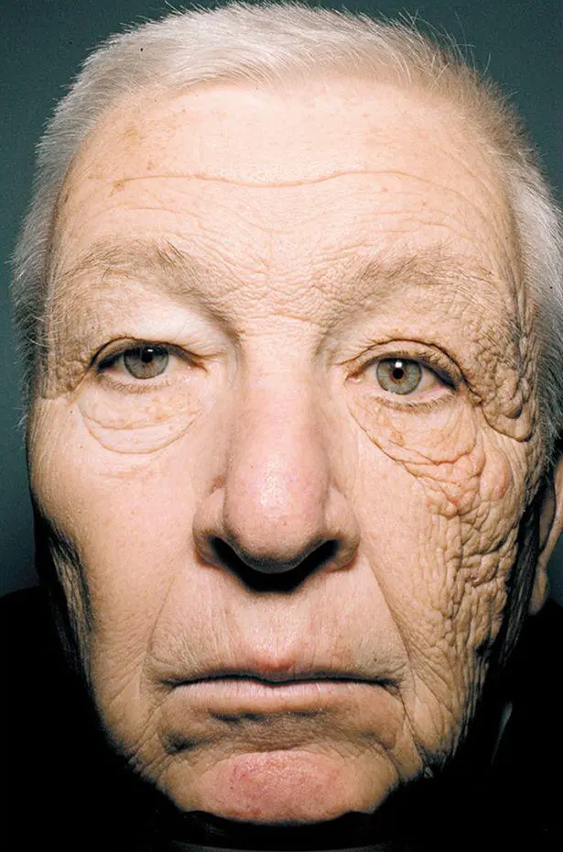
True or False
UV rays can cause your skin to wrinkle
True
Notes:
True.
It is estimated that up to 90% of wrinkles are caused by exposure to UV rays. In fact, UV rays are the main cause for premature aging, along with cigarette smoking.
The man in the picture was a truck driver. You can clearly see that one side of his face, which was the side next to the window, is much more aged than the other side.

Slide 41
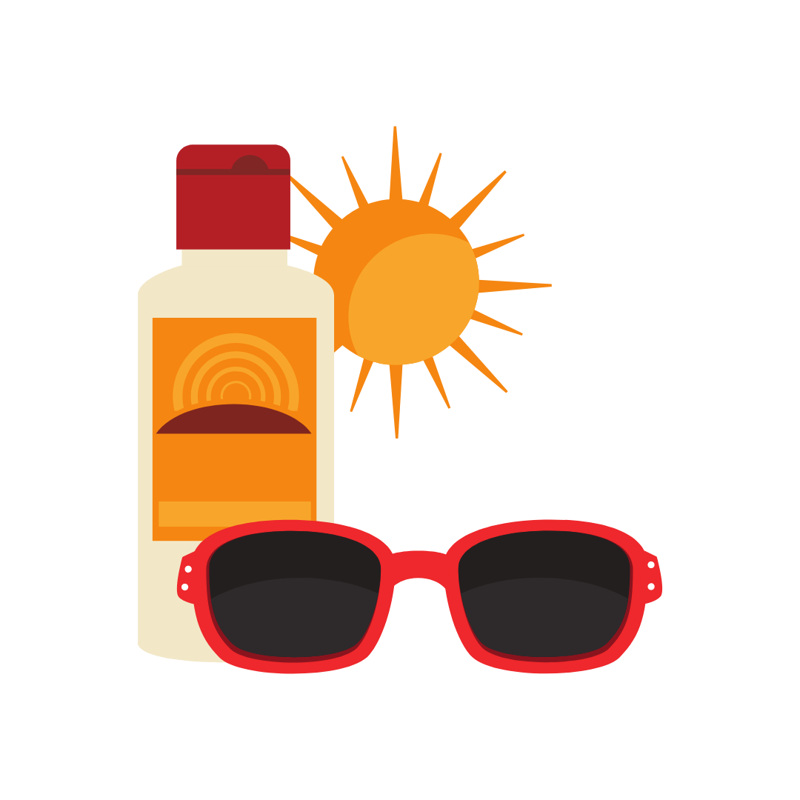
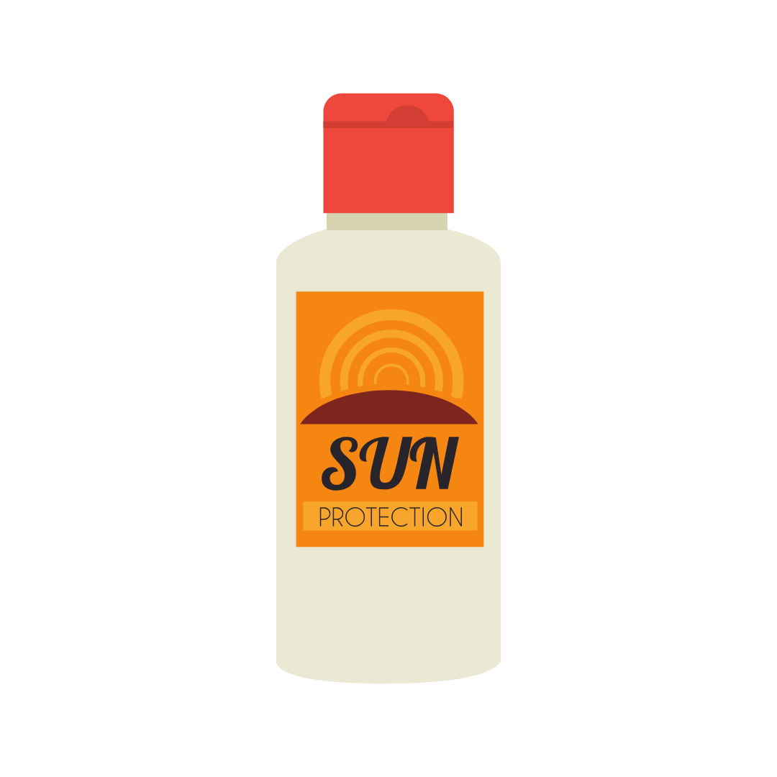
Tips To Protect Yourself
Check your moles at least once a month
Don’t sunbathe or use tanning beds
Avoid sun exposure between 10 am and 4 pm
Protect yourself with long sleeves, pants, sunglasses and a wide brimmed hat
Find some shade!
Use sunscreen with SPF 30 or higher
Notes:
(Read slide)
But we are also looking for sunscreen with SPF 30 and something else… Does anyone remember what that was?
Answer: Waterproof sunscreen! You might think you only need waterproof sunscreen when going swimming, but it’s also for when we are sweating. Waterproof sunscreen will prevent it from rubbing off your skin while sweating.

Slide 42
Questions?
Notes:
(Final slide)
Does anyone have any questions?
(If you don’t know the answers to their questions, don’t try to guess. Tell them to ask their parents, google it when they get home or to ask their doctor next time they see them)

Slide 43
Special Thanks
To review what you have learned today go to:
https://www.surveymonkey.com/r/SunSafety6-7
@cdnskincancerfd
@CanadianSkinCancerFoundation

